Slide 1
Biesbroek’s Class 1/2
Wednesday, June 17, 2020

Slide 2
Table of contents
Morning Message
Reading
Writing
Math
Daily Physical Activity

Slide 3
Morning message
Hello Kiddos,
Happy Wednesday! Last Wednesday! I would hide my treasure in my backyard, for sure. Today, let’s look for words ending in ‘mp’ in our reading, we will read How I Became a Pirate again and make an inference, and we will review place value in Math.
Happy Learning,
Mrs. Biesbroek

Slide 4
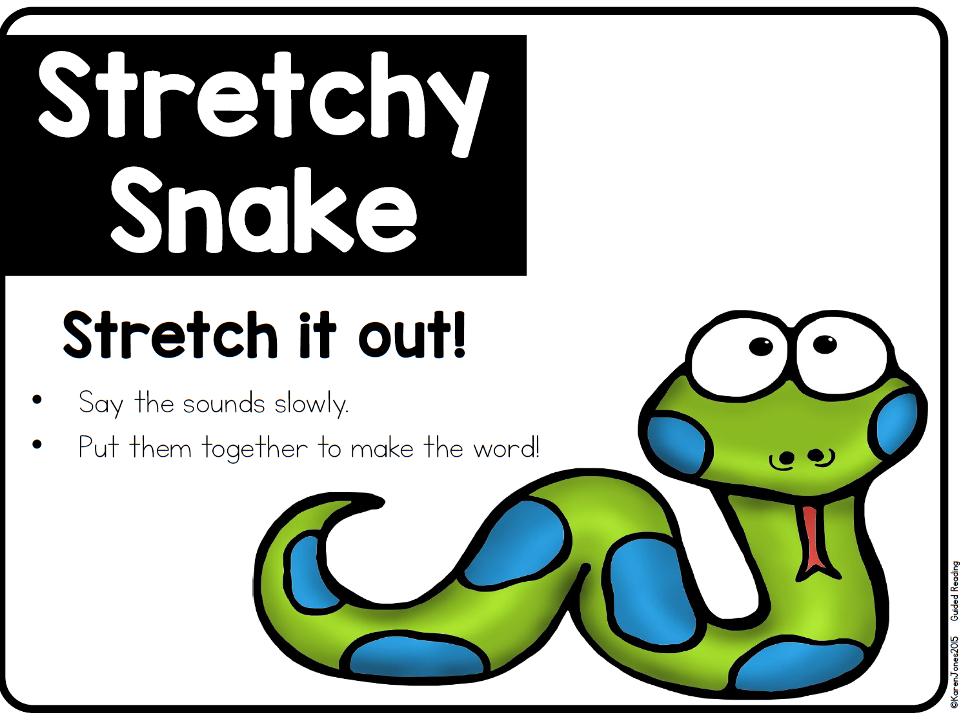
Reading
Step 1
Click and watch the video.
Step 2
Read a book from home or on RAZ kids.
Find any words that end in ‘mp' in your book. Remember if you get to a tricky word – stretch out each sounds using ‘Stretchy Snake’.
Step 3
Share the words you found with a parent or share it with Mrs. Biesbroek in an email.
I can apply a variety of strategies to help solve words.

Slide 5
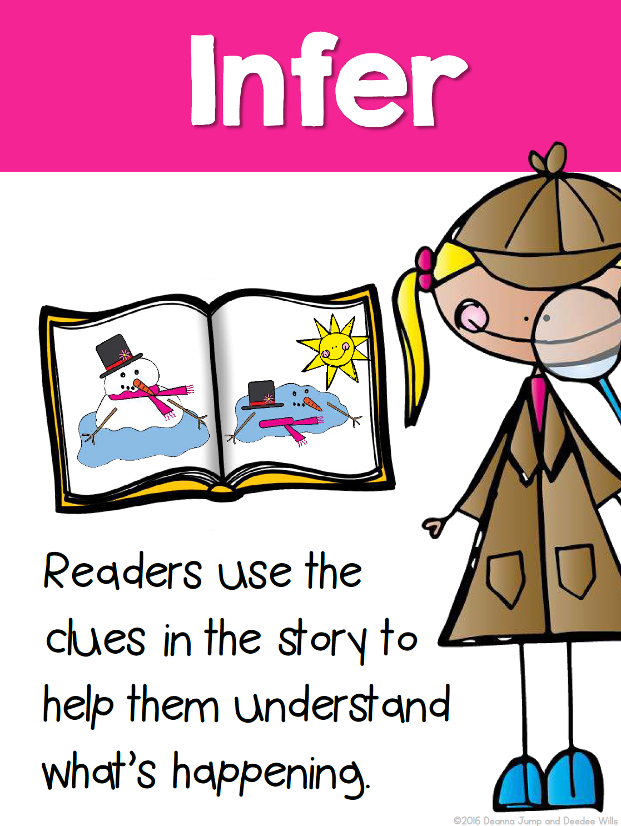
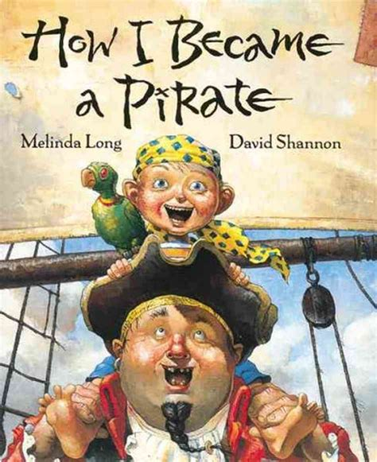
Writing
Step 1
Click the video to listen to Mrs. Biesbroek read How I Became a Pirate. Today we will be making an inference.
Step 2
Think about why do you think pirates slept with one eye open?
Step 3
Open a Word Document and title it “Pirate – Inference” and write why you think they slept with one eye open.
I can use supporting details to identify a main idea in a story.

Slide 6
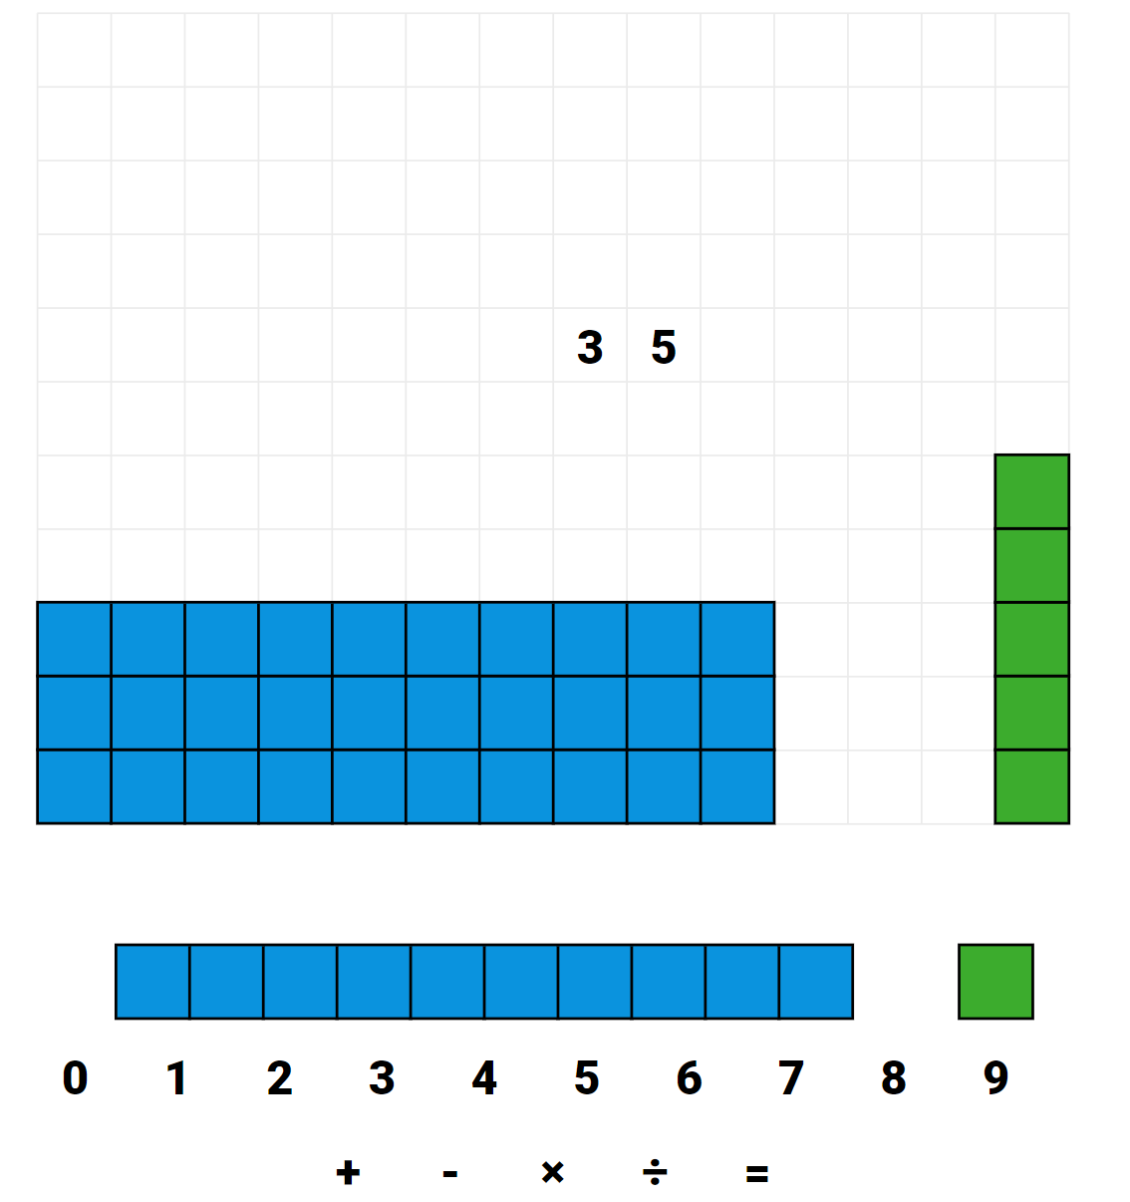
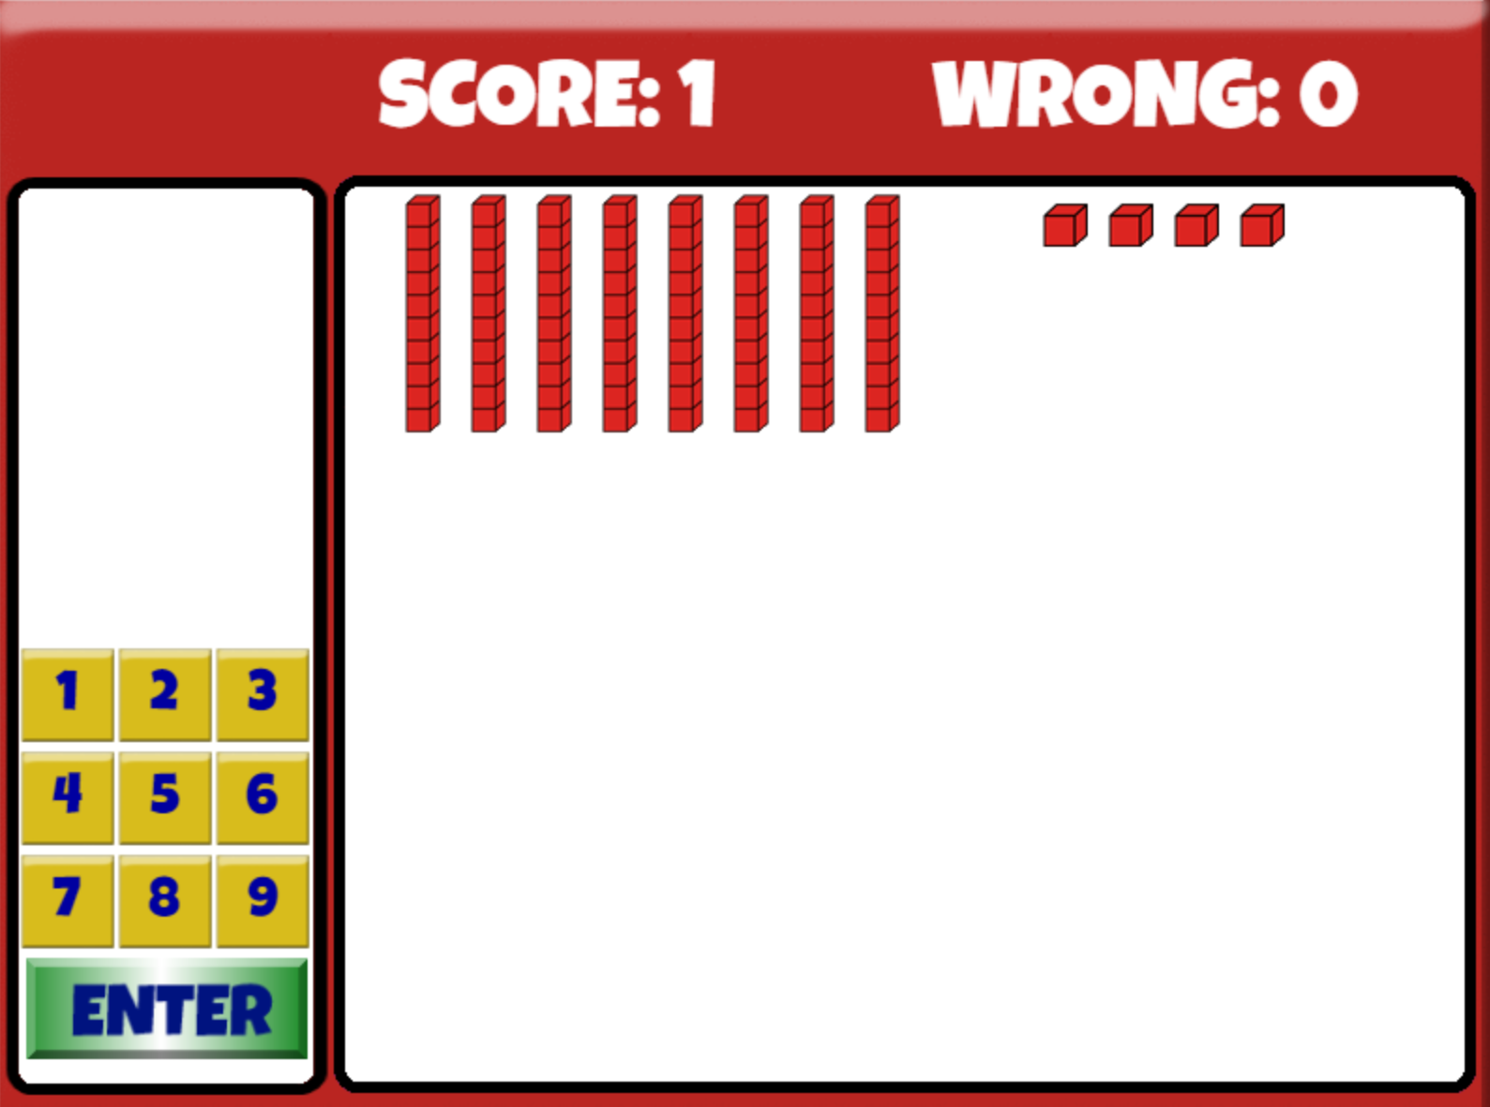
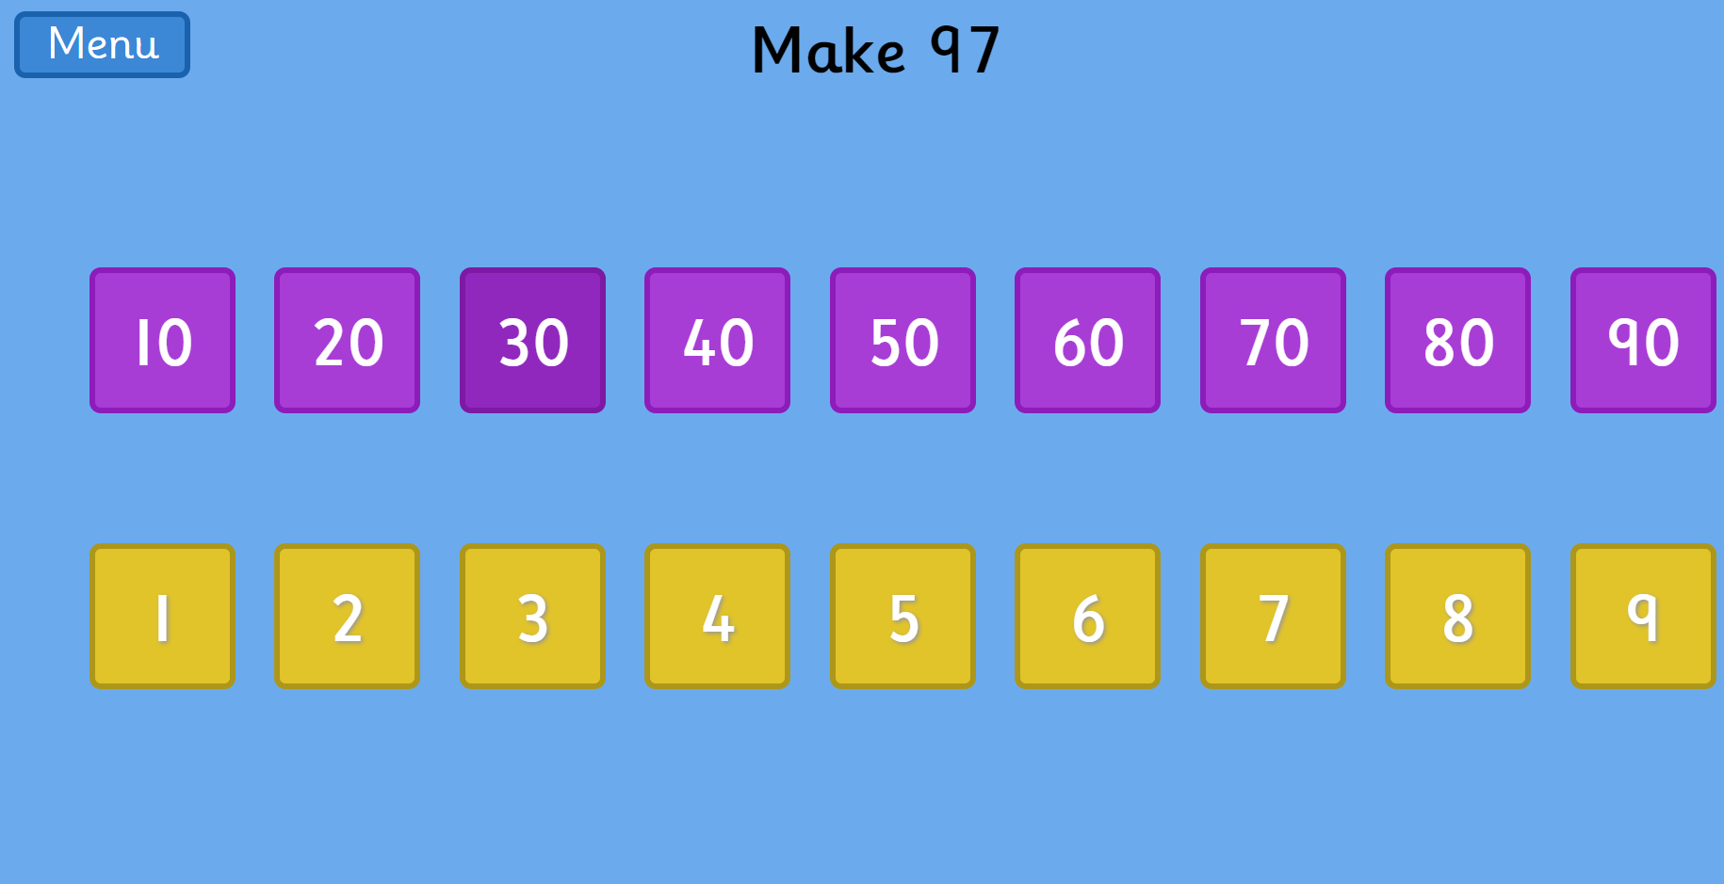
Math
Step 1
Click the video for a review of place value.
Step 2
Practice using the Base Ten blocks to make numbers.
Add the number the blocks represent.
Step 3
Make the number using expanded form.
I can represent and describe numbers to 100 pictorially.

Slide 7
DAILY PHYSICAL ACTIVITY
Choose one (or more) activities for your DPA.
GoNoodle
Fresh Start Fitness
Maximo
Calming Down
Mrs. McIntyre DPA

