Slide 1
BRAICO’s Class 1/2
Wednesday, June 10, 2020

Slide 2
Table of contents
Morning Message
Reading
Writing
Math
Daily Physical Activity

Slide 3
Morning message
Hello Kiddos,
Happy Wednesday! I also get frustrated when I draw and it doesn’t look right. It doesn’t stop me from trying. Today, let’s look for words that end with ‘nd’ in our reading, we will read ish again and look at the problem and solution of the story, and we review 3D shapes in Math.
Happy Learning,
Mr. Braico

Slide 4
Reading
Step 1
Click and watch the video.
Step 2
Read a book from home or on RAZ kids.
Find any words that end in ‘nd' in your book. Remember if you get to a tricky word – stretch out each sounds using ‘Stretchy Snake’.
Step 3
Share the words you found with a parent or share it with Mr. Braico in an email or on your ClassDojo portfolio.
I can apply a variety of strategies to help solve words.

Slide 5
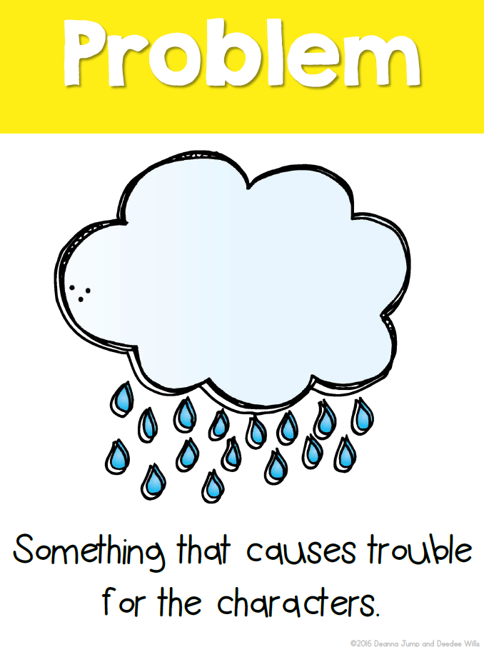
Writing
Step 1
Click the video to listen to Mr. Braico read ish. Today we will look at the problem and solution of the story.
Step 2
Think about the beginning of the story. What was the problem Ramon had?
Start a new Word document called “ish – ProbSol”. Write what you think the problem Ramon had.
Step 3
Next, think about how the problem was solved.
In your Word document, write a sentence to let us know what the solution of the story was.
I can identify the problem and solution of a story.

Slide 6
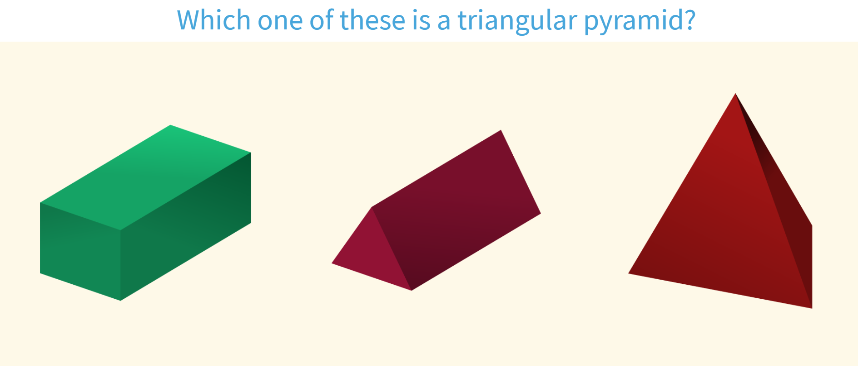
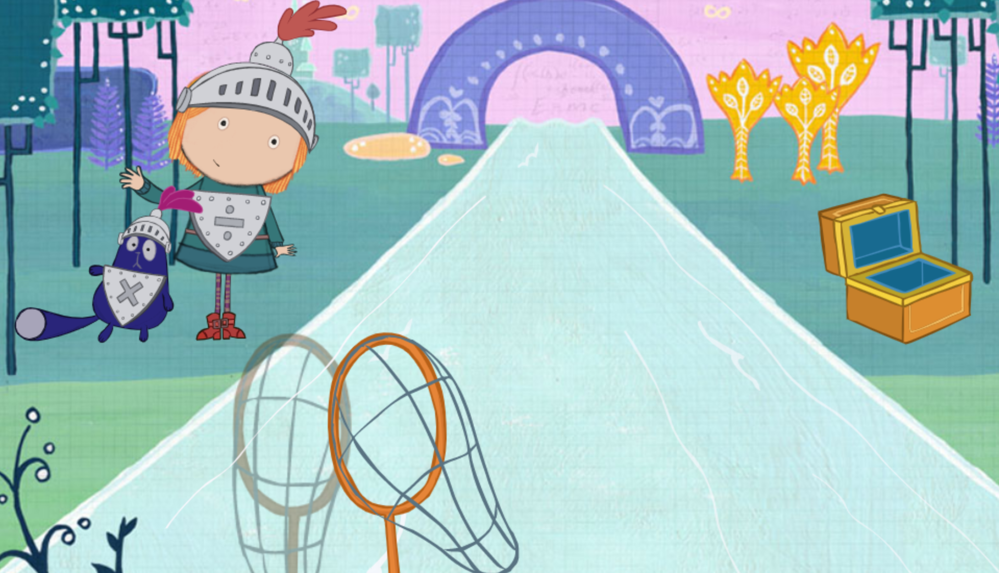
Math
Step 1
Click the video for a review of 3D shapes.
Step 2
Identify the 3D shape.
Catch the 3D shape described.
Step 3
Find 3D shapes around the house and take a picture and send an email or put it up on your ClassDojo portfolio.
For a challenge, try building some 3D shapes with pencils or sticks.
I can use attributes to sort and identify 3D shapes.

Slide 7
DAILY PHYSICAL ACTIVITY
Choose one (or more) activities for your DPA.
GoNoodle
Fresh Start Fitness
Maximo
Calming Down
Mrs. McIntyre DPA

