Slide 1
Biesbroek’s Class 1/2
Wednesday, April 8, 2020

Slide 2
Table of contents
Morning Message
Reading
Writing
Math
Daily Physical Activity

Slide 3
Morning message
Hello Grade ½’s,
Happy Wednesday! Today we will be looking at the ‘ch’ digraph, we are making butterfly life cycles, and practicing addition and subtraction with fact families.
Happy Learning,
Mrs. Biesbroek

Slide 4
Reading
Step 1
Click and watch the video.
Step 2
Read a book from home or on RAZ kids.
Find any ‘ch’ words in your book. Remember to stretch each sound like Stretchy Snake.
Step 3
Share what words you found with a parent or with Mrs. Biesbroek in an email.
Krystal.Biesbroek@lethsd.ab.ca
I can apply a variety of strategies to help solve words.

Slide 5
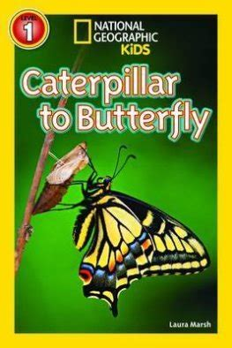
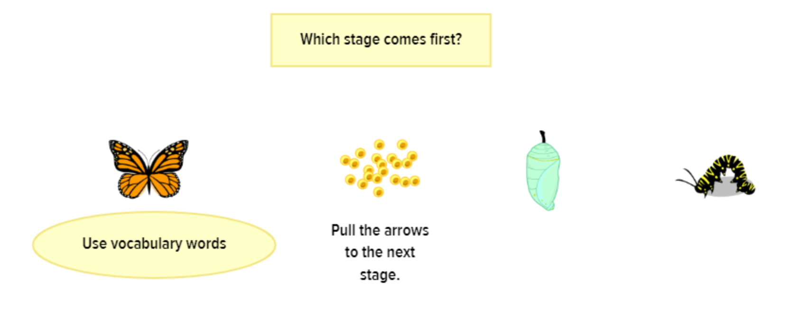
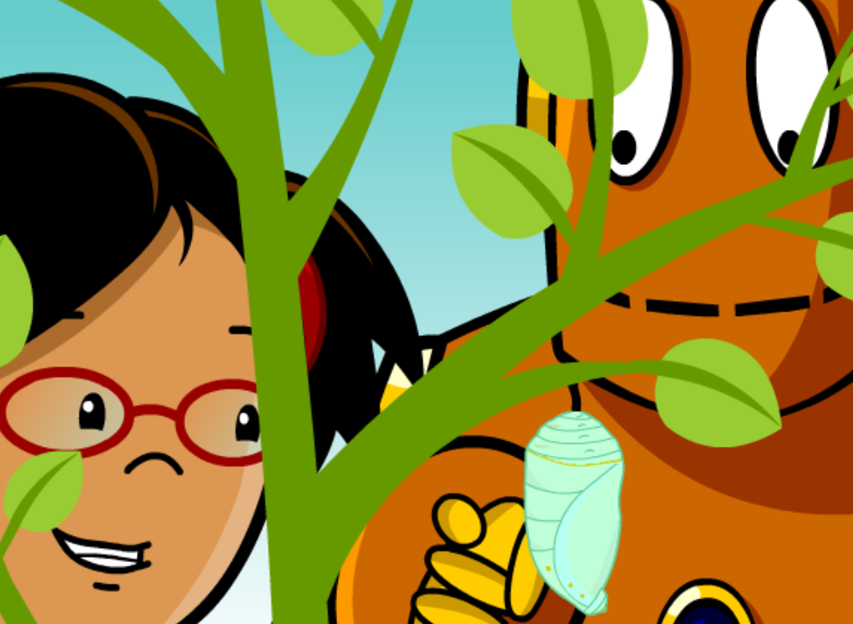
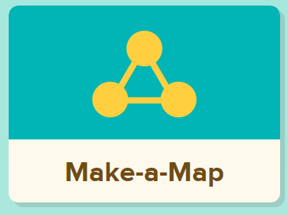
Writing
Step 1
Click and watch Mr. Braico reading the book.
Focus from 1:01 to 4:17 or listen to the whole thing.
Step 2
Watch the video about butterflies.
Step 3
Click Make a Map under the video to make a life cycle of a butterfly.
Click Images and Key Words to add information to your life cycle.
I can record ideas and information in ways that make sense.

Slide 6
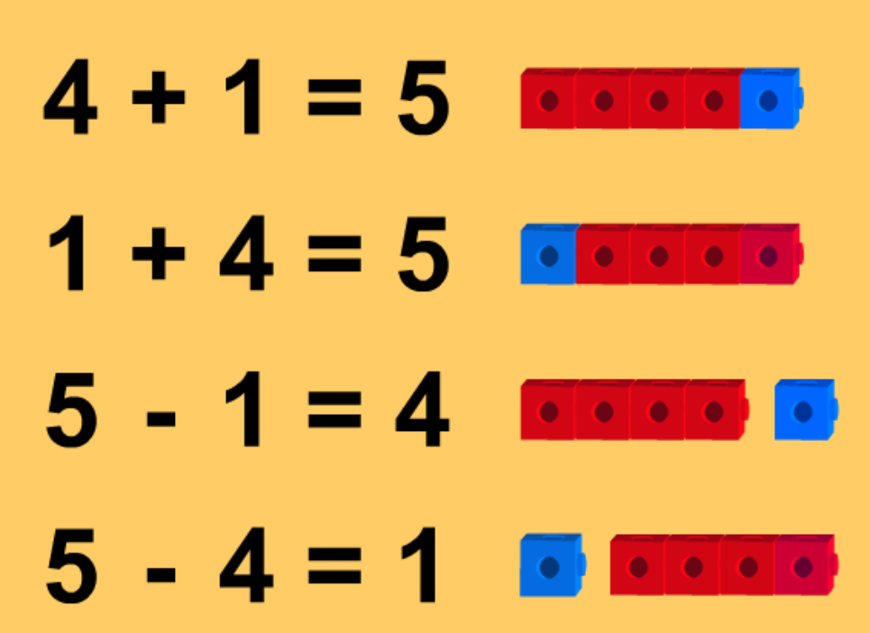
Math
Step 1
Click the video to learn more about addition and subtraction fact families.
User: westminster1
Password: westie1
Step 2
Do the EASY or HARD quiz found under the video.
Step 3
Head to the link.
Choose addition and subtraction. Choose 3 numbers that are in the fact family to get rid of the blocks. For example, 3, 2, and 5.
I can show my understanding of adding and subtracting numbers.

Slide 7
DAILY PHYSICAL ACTIVITY
Choose one (or more) activities for your DPA.
GoNoodle
Fresh Start Fitness
Maximo
Calming Down
Mrs. McIntyre DPA

