Slide 1
Biesbroek’s Class 1/2
Tuesday, June 2, 2020

Slide 2
Table of contents
Morning Message
Reading
Writing
Math
Daily Physical Activity

Slide 3
Morning message
Hello Kiddos,
Happy Tuesday! Pout-Pout Fish is now a Kiss-Kiss fish!?! That is great. We will look for ‘igh’ words in our reading today, we will read The Pout-Pout Fish again and make a connection to our lives, and we look at time to the hour in Math.
Happy Learning,
Mrs. Biesbroek

Slide 4
Reading
Step 1
Click and watch the video.
Step 2
Read a book from home or on RAZ kids.
Find any ‘igh’ words in your book. Remember if you get to a tricky word - look for chunks you know by using ‘Chunky Monkey’.
Step 3
Share the words you found with a parent or share it with Mrs. Biesbroek in an email.
I can apply a variety of strategies to help solve words.

Slide 5
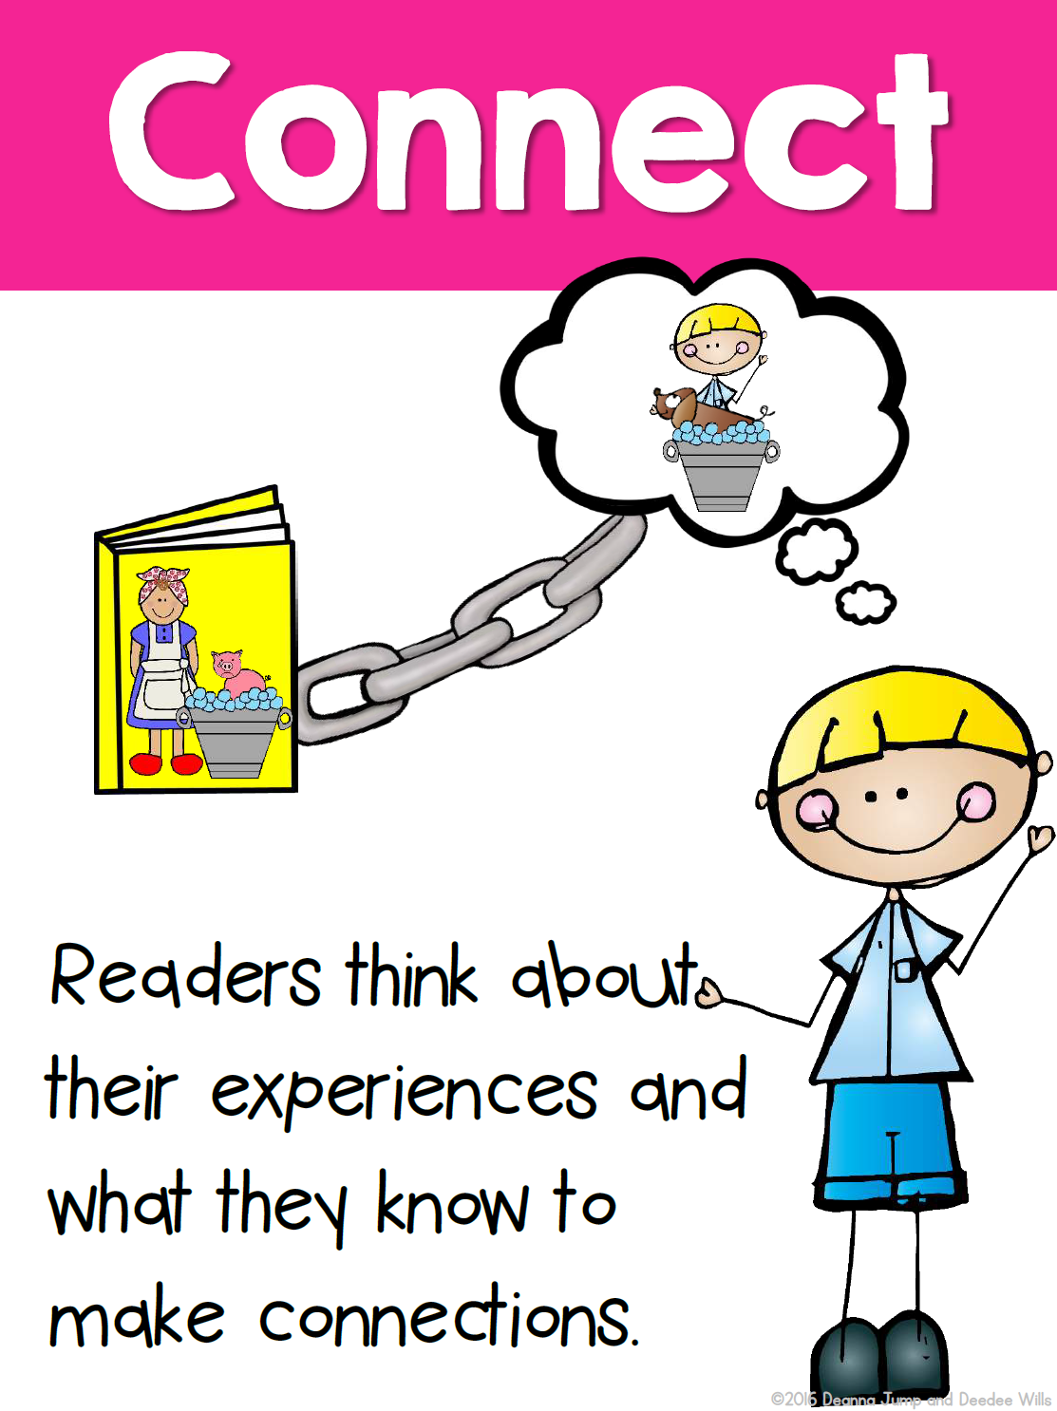
Writing
Step 1
Click the video to listen to Mr. Braico read The Pout-Pout Fish.
Step 2
Today, we will make a connection to our lives. Mr. Fish was gloomy until a fish gave him a kiss. What can you do to cheer someone up when they are gloomy?
Step 3
Start a new word document called “Pout Pout – Connection”. Write at least 3 different ways you can cheer someone up when they are gloomy.
I can use past experiences to make a connection.

Slide 6
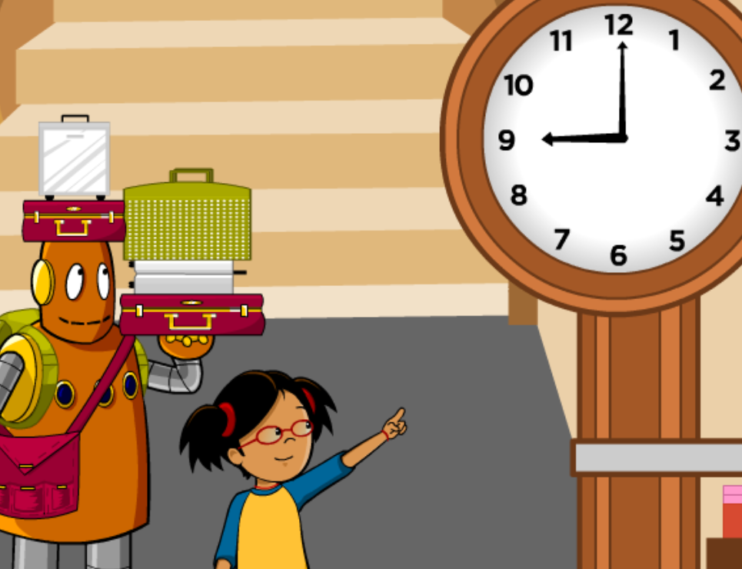
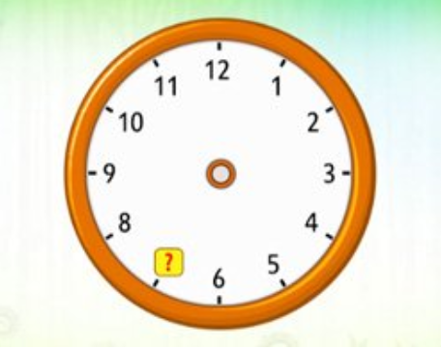
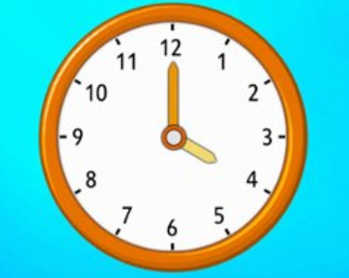
Math
Step 1
Click the video to learn about time to the hour.
User: westminster1
Password: westie1
Step 2
Do the EASY or HARD quiz found under the video.
Step 3
What are the times on the clock?
Click Sign In → Class → JUMJUU → find name
Password: 1234
Tell time to the hour.
I can relate the size of a unit of measure to the number of units to measure time.

Slide 7
DAILY PHYSICAL ACTIVITY
Choose one (or more) activities for your DPA.
GoNoodle
Fresh Start Fitness
Maximo
Calming Down
Mrs. McIntyre DPA

