Slide 1
Biesbroek’s Class 1/2
Tuesday, June 16, 2020

Slide 2
Table of contents
Morning Message
Reading
Writing
Math
Daily Physical Activity

Slide 3
Morning message
Hello Kiddos,
Happy Tuesday! Last Tuesday! We will look for words ending with ‘ck’ in our reading today, we will read How I Became a Pirate again and make a connection to the story, and we review subtraction in Math.
Happy Learning,
Mrs. Biesbroek

Slide 4
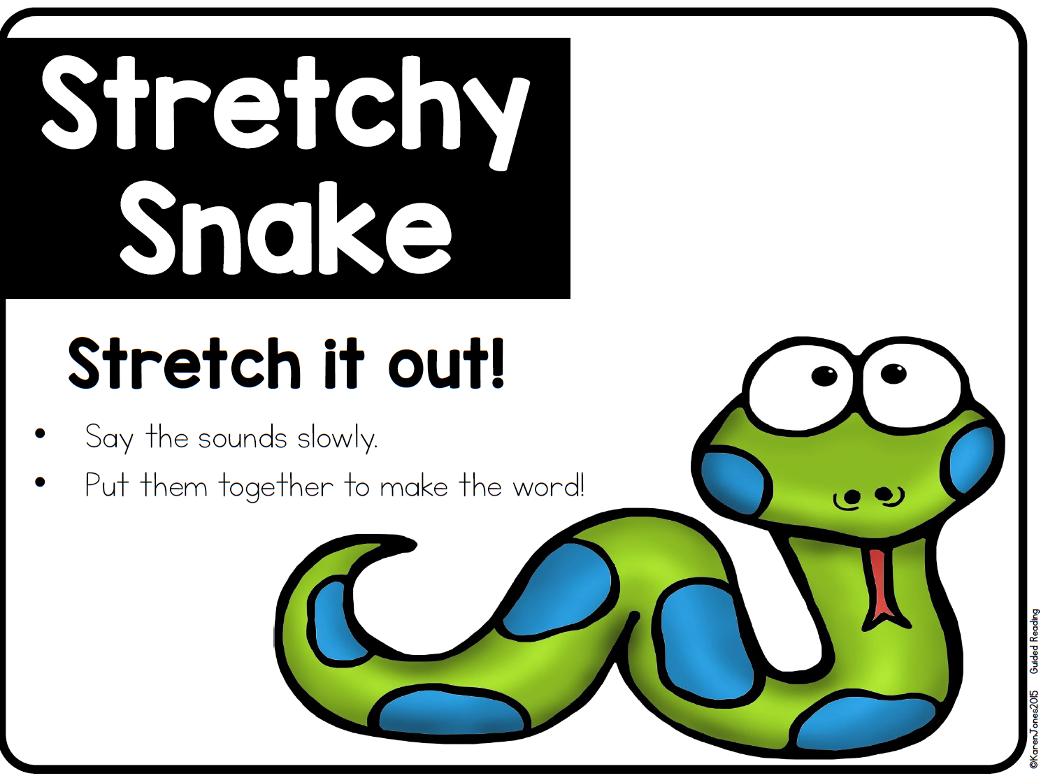
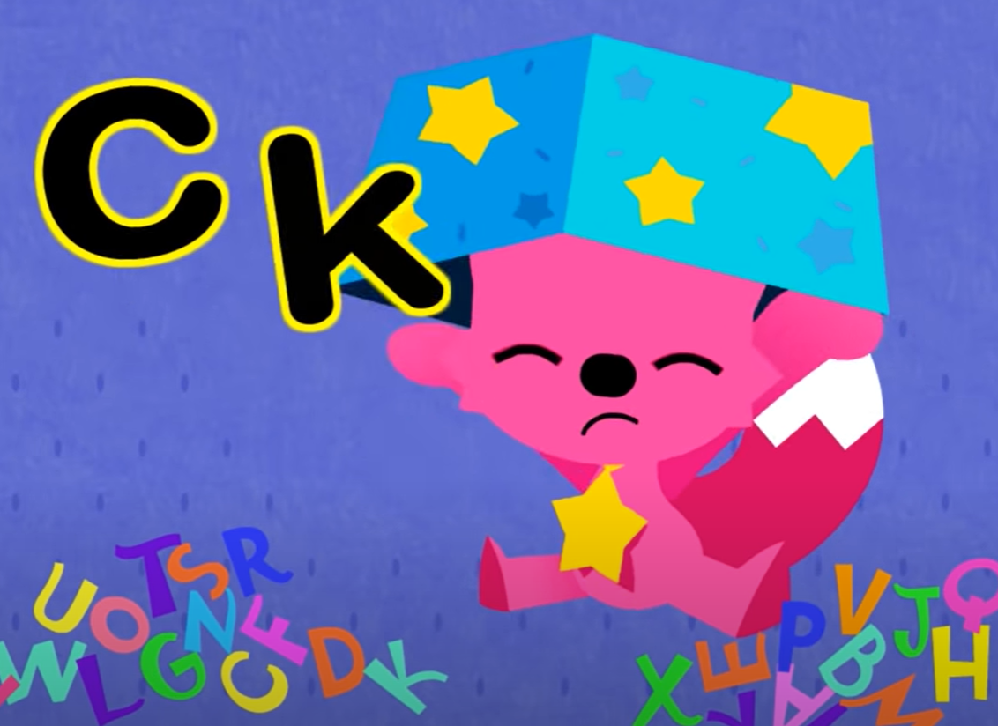
Reading
Step 1
Click and watch the video.
Step 2
Read a book from home or on RAZ kids.
Find any words that end in ‘ck' in your book. Remember if you get to a tricky word – stretch out each sounds using ‘Stretchy Snake’.
Step 3
Share the words you found with a parent or share it with Mrs. Biesbroek in an email.
I can apply a variety of strategies to help solve words.

Slide 5
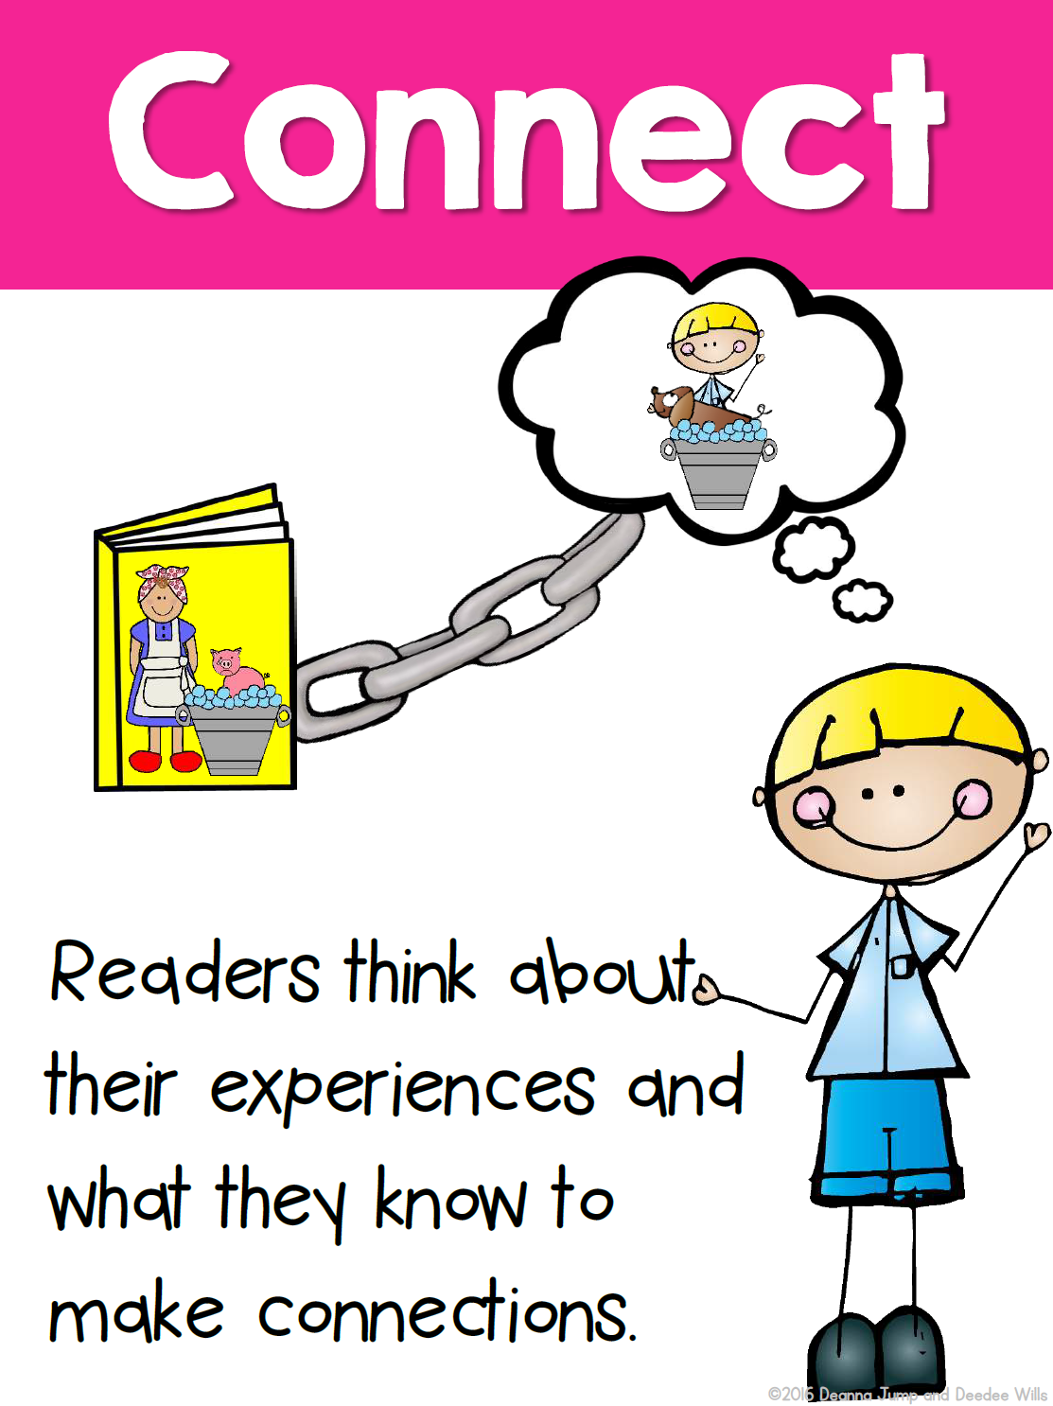
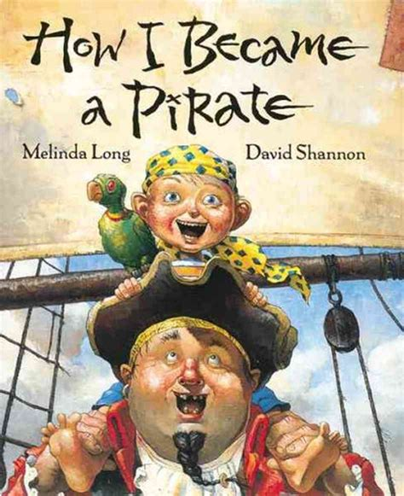
Writing
Step 1
Click the video to listen to Mrs. Biesbroek read How I Became a Pirate. Today we will be making a connection.
Step 2
Today, we will make a connection to the story. If you had a treasure, where would you hide it?
Step 3
Start a new word document called “Pirate – Connection”. Write at least 3 sentences of where you would hide it and why.
I can use past experiences to make a connection.

Slide 6
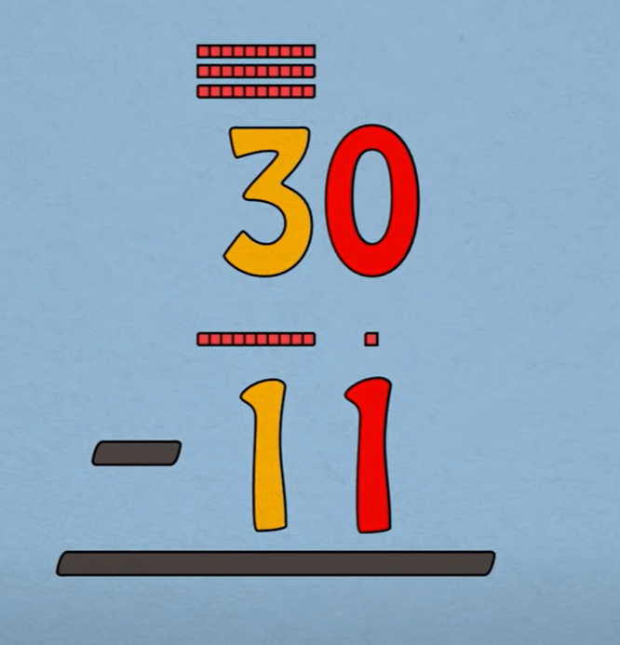
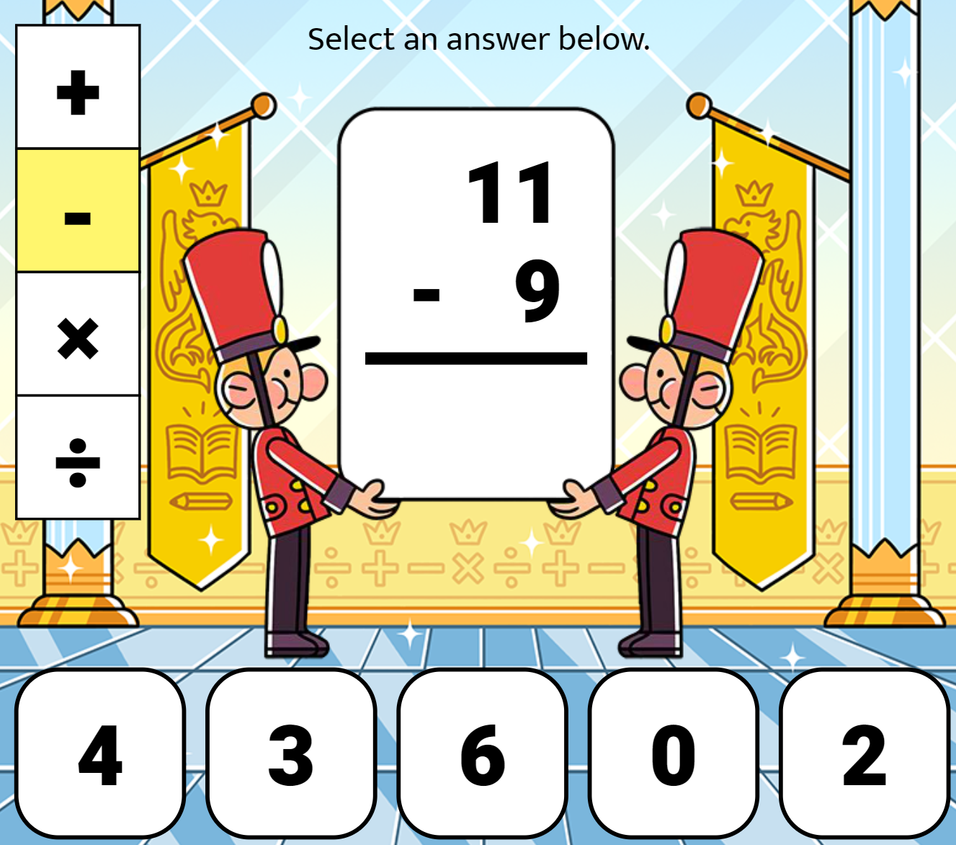
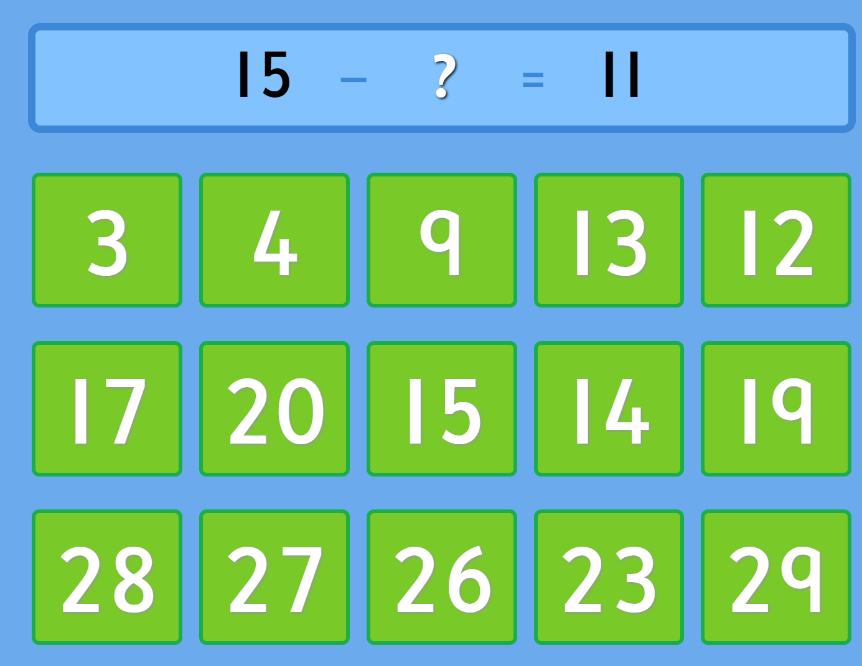
Math
Step 1
Click the video for a review subtraction.
Step 2
Choose the correct missing number.
Choose the correct number to answer the question.
Step 3
Choose the correct number to solve the problem.
I can demonstrate an understanding of subtraction.

Slide 7
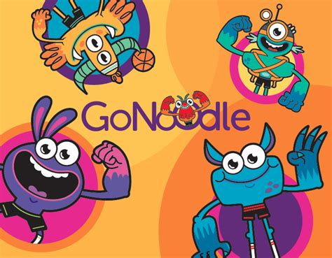
DAILY PHYSICAL ACTIVITY
Choose one (or more) activities for your DPA.
GoNoodle
Fresh Start Fitness
Maximo
Calming Down
Mrs. McIntyre DPA

