Slide 1
Biesbroek’s Class 1/2
Tuesday, April 28, 2020

Slide 2
Table of contents
Morning Message
Reading
Writing
Math
Daily Physical Activity
Word Work

Slide 3
Morning message
Hello Boys & Girls,
Happy Tuesday! I hope you were able to add some action to your story through dialogue. Today we will be looking at the ‘fl’ consonant blend, we will read The Rabbit Listened and look at the resolution or ending of a story, and we will learn about measuring using nonstandard units.
Happy Learning,
Mrs. Biesbroek

Slide 4
Word work
Step 1
Click and watch the video.
Step 2
Read a book from home or on RAZ kids.
Find any ‘fl’ words in your book. Remember to put your lips together to get ready for the sounds using Lips the Fish.
Step 3
Share what words you found with a parent or share it with Mrs. Biesbroek in an email.
Krystal.Biesbroek@lethsd.ab.ca
I can apply a variety of strategies to help solve words.

Slide 5
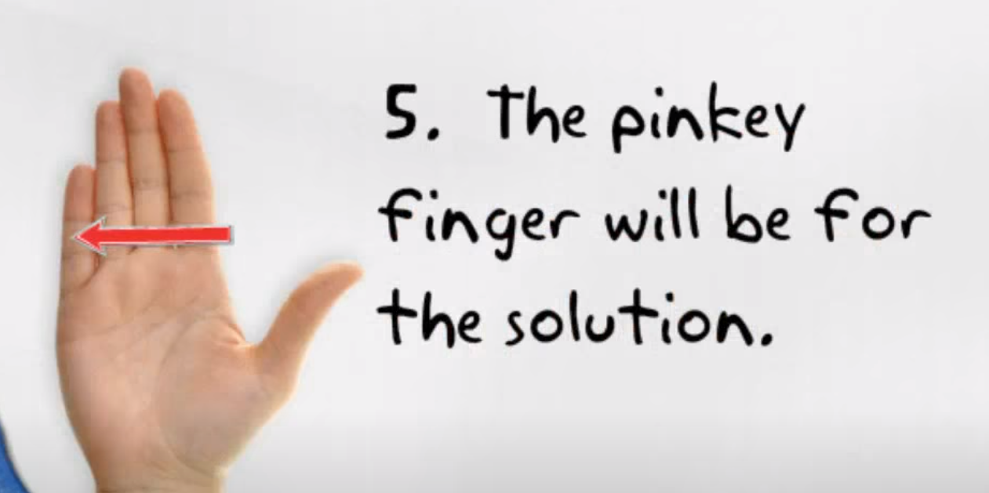
Reading
Step 1
Click and watch the video on resolution/ending.
Step 2
Click and watch Mr. Braico reading The Rabbit Listened. Think about the resolution or ending of the story. How did it end?
Step 3
Understanding how the story ends will help you remember the problem and events of a story. How was Taylor’s problem solved in the resolution or end of the story?
Retell the story to a parent or sibling by using the Story Element 5 from the first video.
I can identify what happens at the end of a story.

Slide 6
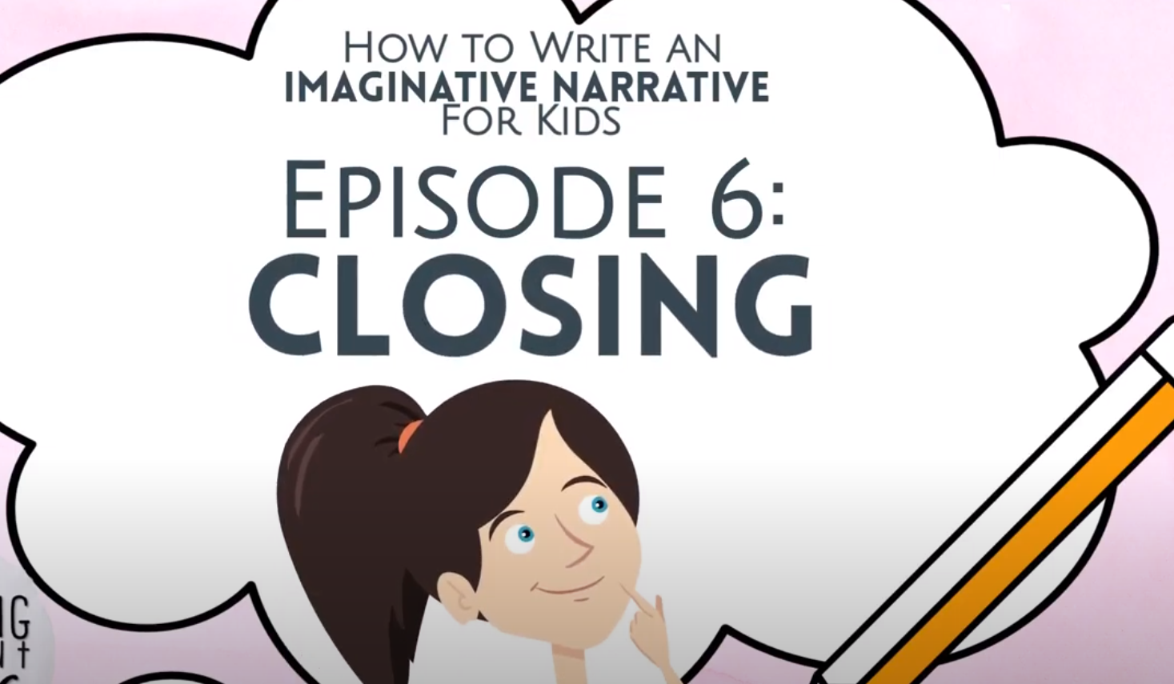
Writing
Step 1
Click the video to learn more about writing an ending.
Step 2
Today, we will continue our fiction writing piece. Think of a way to end your story. How can your characters solve the problem? Will it be a happy or sad ending?
Step 3
Write a strong ending for your “My Story” Word document you started last time. Please remember to save your work.
I can create narrative stories with an ending.

Slide 7
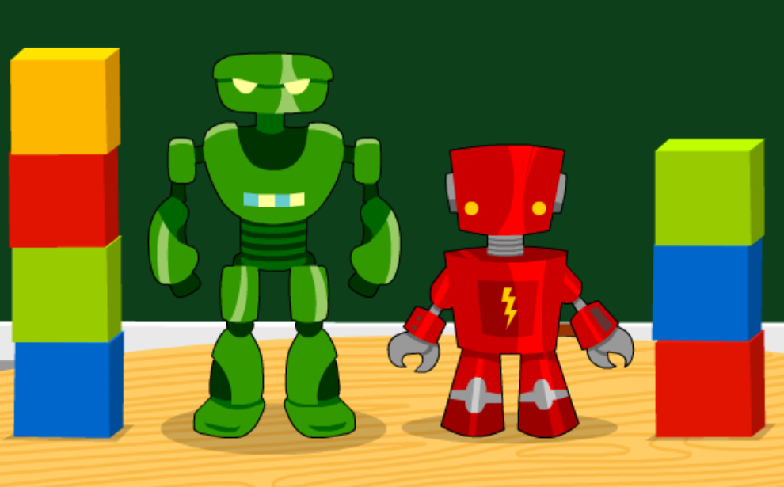
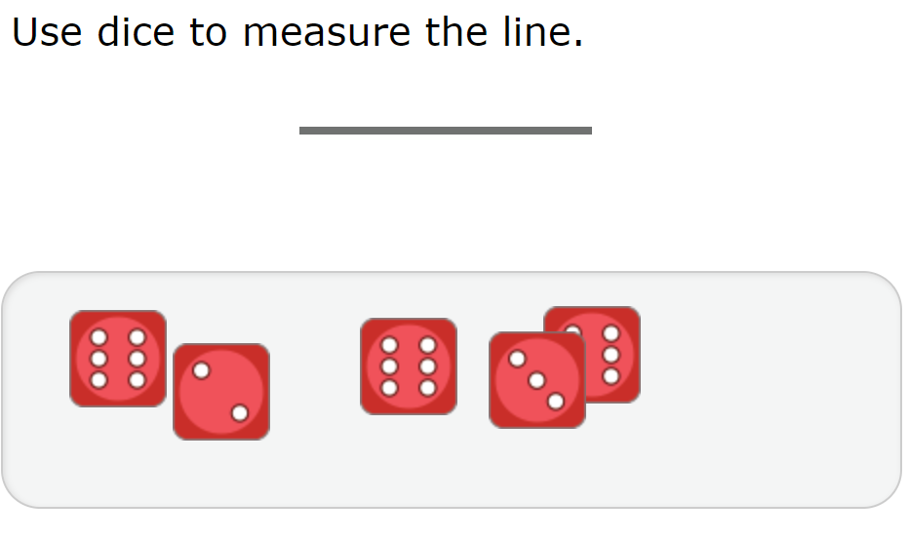
Math
Step 1
Click the video to learn more about nonstandard measurement.
User: westminster1
Password: westie1
Step 2
Do the EASY or HARD quiz found under the video.
Step 3
Use the objects to measure the line.
Take a picture of an object you measured using nonstandard units. For example, a shoe using Cheerios. Post it in your Portfolio on ClassDojo.
I can measure length using nonstandard units.

Slide 8
DAILY PHYSICAL ACTIVITY
Choose one (or more) activities for your DPA.
GoNoodle
Fresh Start Fitness
Maximo
Calming Down
Mrs. McIntyre DPA

