Slide 1
Biesbroek’s Class 1/2
Tuesday, April 7, 2020

Slide 2
Table of contents
Morning Message
Reading
Writing
Math
Daily Physical Activity

Slide 3
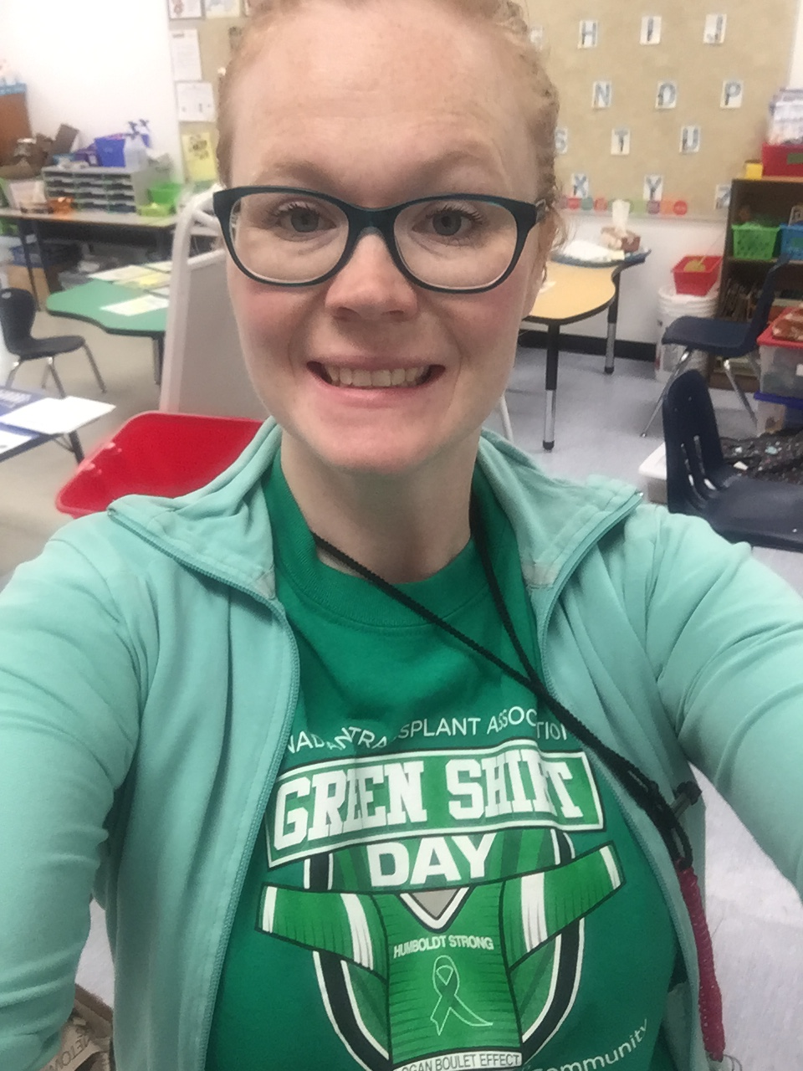
Morning message
Hello Kiddos,
Happy Green shirt day! I hope you had a good weekend.
Week 2 of online learning! I think we are getting into the routine of things. Today we will be looking at the ‘sh’ digraph, we are making inferences about butterflies, and practicing subtracting without regrouping.
Happy Learning,
Mrs. Biesbroek

Slide 4
Reading
Step 1
Click and watch the video.
Step 2
Read a book from home or on RAZ kids.
Find any ‘sh’ words in your book. Remember to stretch each sound like Stretchy Snake.
Step 3
Share what words you found with a parent or share it with Mr.s Biesbroek in an email..
Krystal.Biesbroek@lethsd.ab.ca
I can apply a variety of strategies to help solve words.

Slide 5
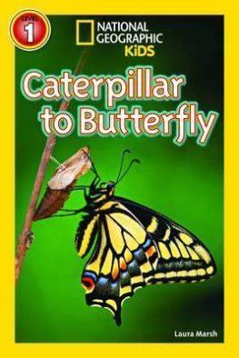
Writing
Step 1
Click and watch Mr. Braico reading the book.
Head to 1:40 and stop at 2:13 or listen to the whole thing.
Step 2
The author says, “Each egg is close to food.” Why do you think the butterfly lays its eggs close to food? Write about why you thought that.
Step 3
Click the link to show your learning.
I can draw conclusions from information given.

Slide 6
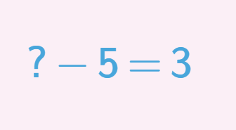
Math
Step 1
Click the video to learn more about subtracting without regrouping.
User: westminster1
Password: westie1
Step 2
Do the EASY or HARD quiz found under the video.
Step 3
Head to the link.
Type or click the numbers to solve the subtraction problems.
I can show my understanding of subtracting numbers.

Slide 7
DAILY PHYSICAL ACTIVITY
Choose one (or more) activities for your DPA.
GoNoodle
Fresh Start Fitness
Maximo
Calming Down
Mrs. McIntyre DPA

