Slide 1
Biesbroek’s Class 1/2
Thursday, April 9, 2020

Slide 2
Table of contents
Morning Message
Reading
Writing
Math
Daily Physical Activity

Slide 3
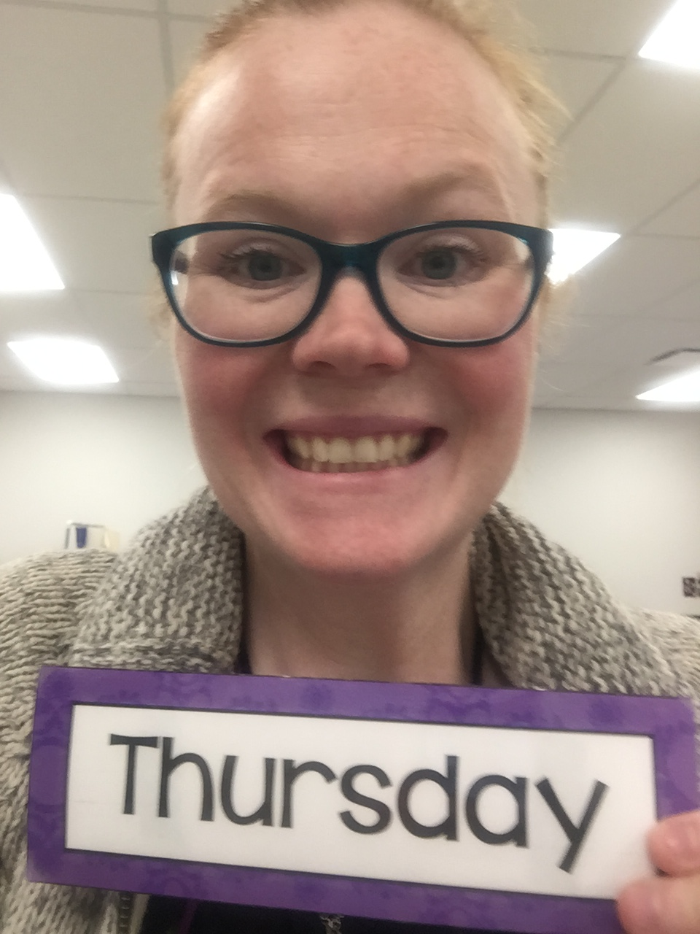
Morning message
Hello Kiddos,
Happy Thursday! Last day of the school week! Today we will be looking at the ‘th’ digraph, we are comparing and contrasting butterflies and an insect of your choice, and practicing adding and subtracting by 10s.
Happy Learning,
Mrs. Biesbroek

Slide 4
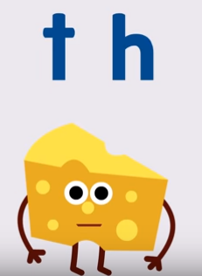
Reading
Step 1
Click and watch the video.
Step 2
Read a book from home or on RAZ kids.
Find any ‘th’ words in your book. Remember to stretch each sound like Stretchy Snake.
Step 3
Share what words you found with a parent or with Mrs. Biesbroek in an email.
Krystal.Biesbroek@lethsd.ab.ca
I can apply a variety of strategies to help solve words.

Slide 5
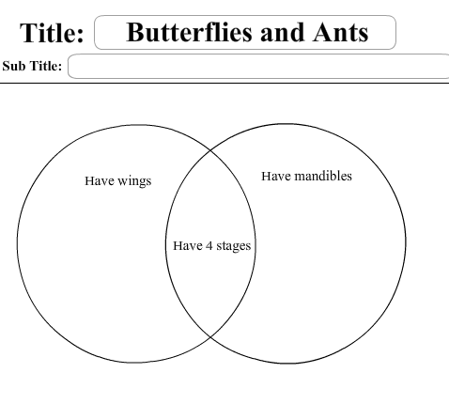
Writing
Step 1
Head to Online Resource Centre by clicking here.
User: LA33
Password: 7434
Go to PebbleGo Science.
Step 2
Search insects and then click one to learn all about that insect.
How are they the same as butterflies? How are they different?
Step 3
Click the link to make a Venn diagram. One side is for butterflies, one side is for your insect, and what do they have that is similar goes in the middle.
I can identify information according to similarities and differences.

Slide 6
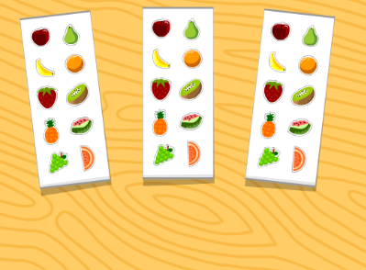
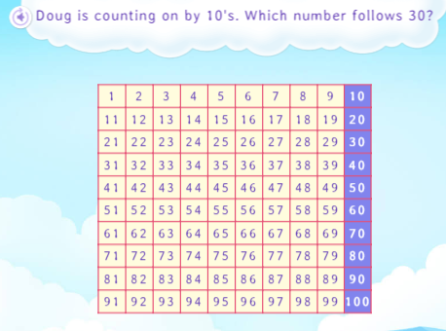
Math
Step 1
Click the video to learn more about adding and subtracting by 10s.
User: westminster1
Password: westie1
Step 2
Do the EASY or HARD quiz found under the video.
Step 3
Head to the link.
Click practice now and answer the questions by counting by 10s.
I can show my understanding of adding and subtracting numbers.

Slide 7
DAILY PHYSICAL ACTIVITY
Choose one (or more) activities for your DPA.
GoNoodle
Fresh Start Fitness
Maximo
Calming Down
Mrs. McIntyre DPA

