Slide 1
Biesbroek’s Class 1/2
Thursday, June 4, 2020

Slide 2
Table of contents
Morning Message
Reading
Writing
Math
Daily Physical Activity

Slide 3
Morning message
Hello Kiddos,
Happy Thursday! I learned more about Mr. Fish by looking more closely at his traits. Let’s find some ‘ure’ words in our reading today, read The Pout-Pout Fish again and tell me your favourite part, and let’s look at elapsed time in Math.
Happy Learning,
Mrs. Biesbroek

Slide 4
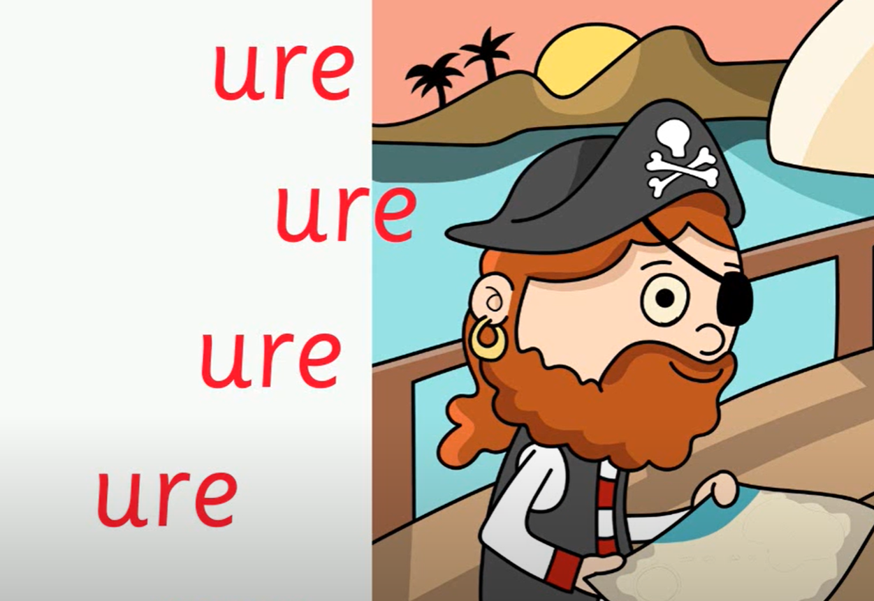
Reading
Step 1
Click and watch the video.
Step 2
Read a book from home or on RAZ kids.
Find any ‘ure’ words in your book. Remember if you get to a tricky word-look for chunks you know by using ‘Chunky Monkey’.
Step 3
Share the words you found with a parent or share it with Mrs. Biesbroek in an email.
I can apply a variety of strategies to help solve words.

Slide 5
Writing
Step 1
Click the video to listen to Mr. Braico read The Pout-Pout Fish.
Step 2
Today, we will write an opinion about the story. Tell me about your favourite part of the story and why.
Step 3
Create a Word document called “Pout Pout – Opinion”. Share your favourite part of the story and why.
I can explain why an event from a story was my personal favourite.

Slide 6
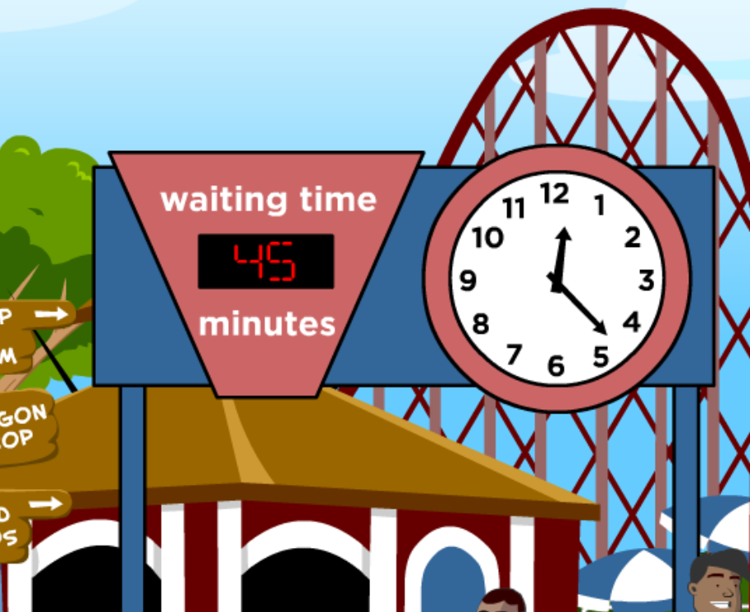
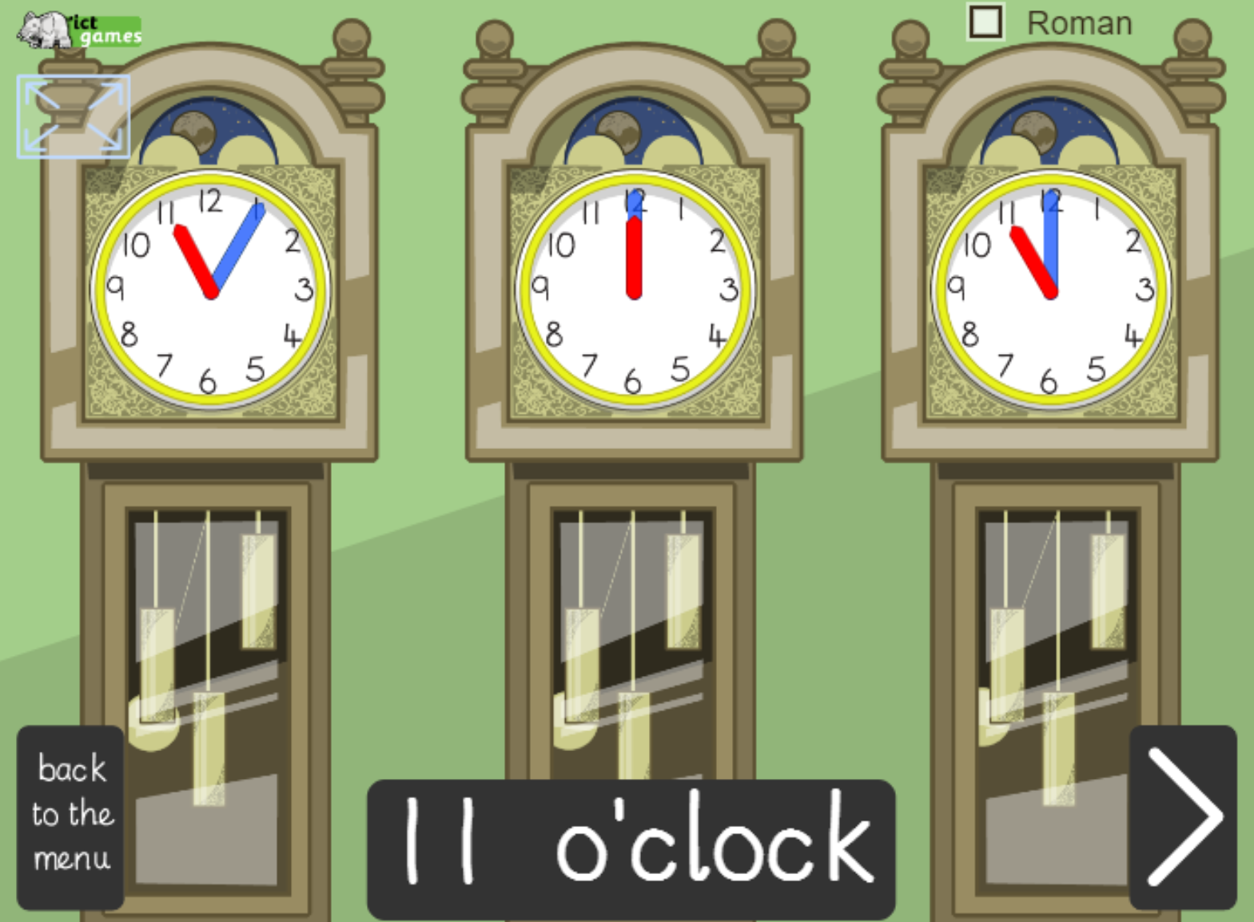
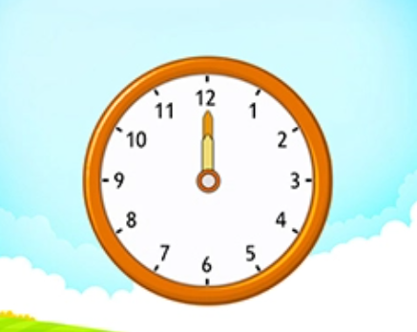
Math
Step 1
Click the video to learn more about elapsed time.
User: westminster1
Password: westie1
Step 2
Do the EASY or HARD quiz found under the video.
Step 3
Choose the correct time to help the mouse
How much time has elapsed?
Click Sign In → Class → JUMJUU → find name
Password: 1234
I can relate the size of a unit of measure to the number of units to measure time.

Slide 7
DAILY PHYSICAL ACTIVITY
Choose one (or more) activities for your DPA.
GoNoodle
Fresh Start Fitness
Maximo
Calming Down
Mrs. McIntyre DPA

