Slide 1
Biesbroek’s Class 1/2
Thursday, June 18, 2020

Slide 2
Table of contents
Morning Message
Reading
Writing
Math
Daily Physical Activity

Slide 3
Morning message
Hello Kiddos,
Happy Thursday! Last Thursday! Maybe they slept with one eye open because they didn’t want anyone stealing their treasure. Let’s find some words ending in ‘ld’ in our reading today, read How I Became a Pirate again and tell me your favourite part, and let’s review word problems in Math.
Happy Learning,
Mrs. Biesbroek

Slide 4
Reading
Step 1
Click and watch the video.
Step 2
Read a book from home or on RAZ kids.
Find any words that end in ‘ld' in your book. Remember if you get to a tricky word – stretch out each sounds using ‘Stretchy Snake’.
Step 3
Share the words you found with a parent or share it with Mrs. Biesbroek in an email.
I can apply a variety of strategies to help solve words.

Slide 5
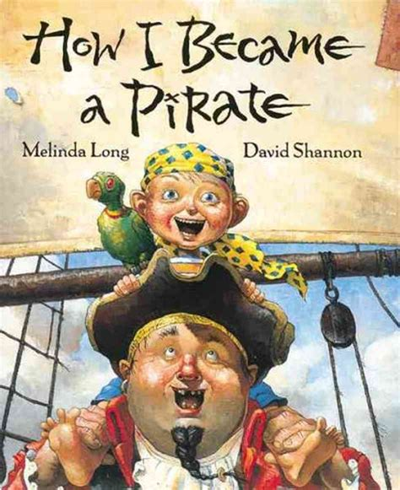
Writing
Step 1
Click the video to listen to Mrs. Biesbroek read How I Became a Pirate.
Step 2
Today, we will write an opinion about the story. Tell me about your favourite part of the story and why.
Step 3
Create a Word document called “Pirate – Opinion”. Share your favourite part of the story and why.
I can explain why an event from a story was my personal favourite.

Slide 6
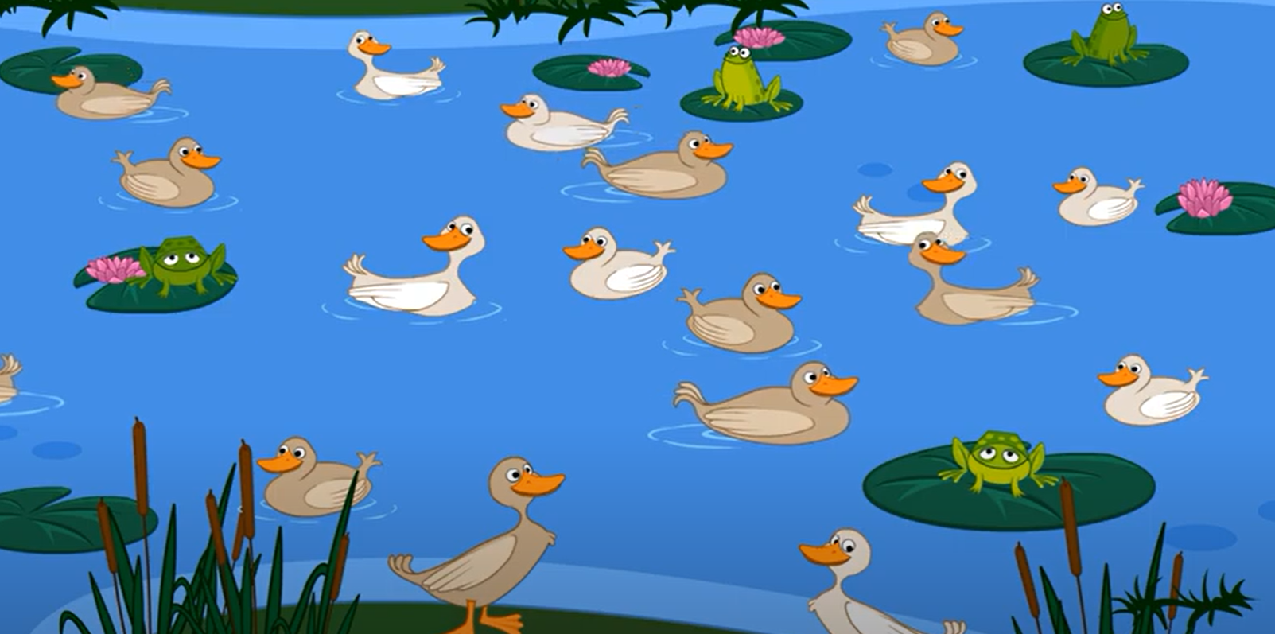
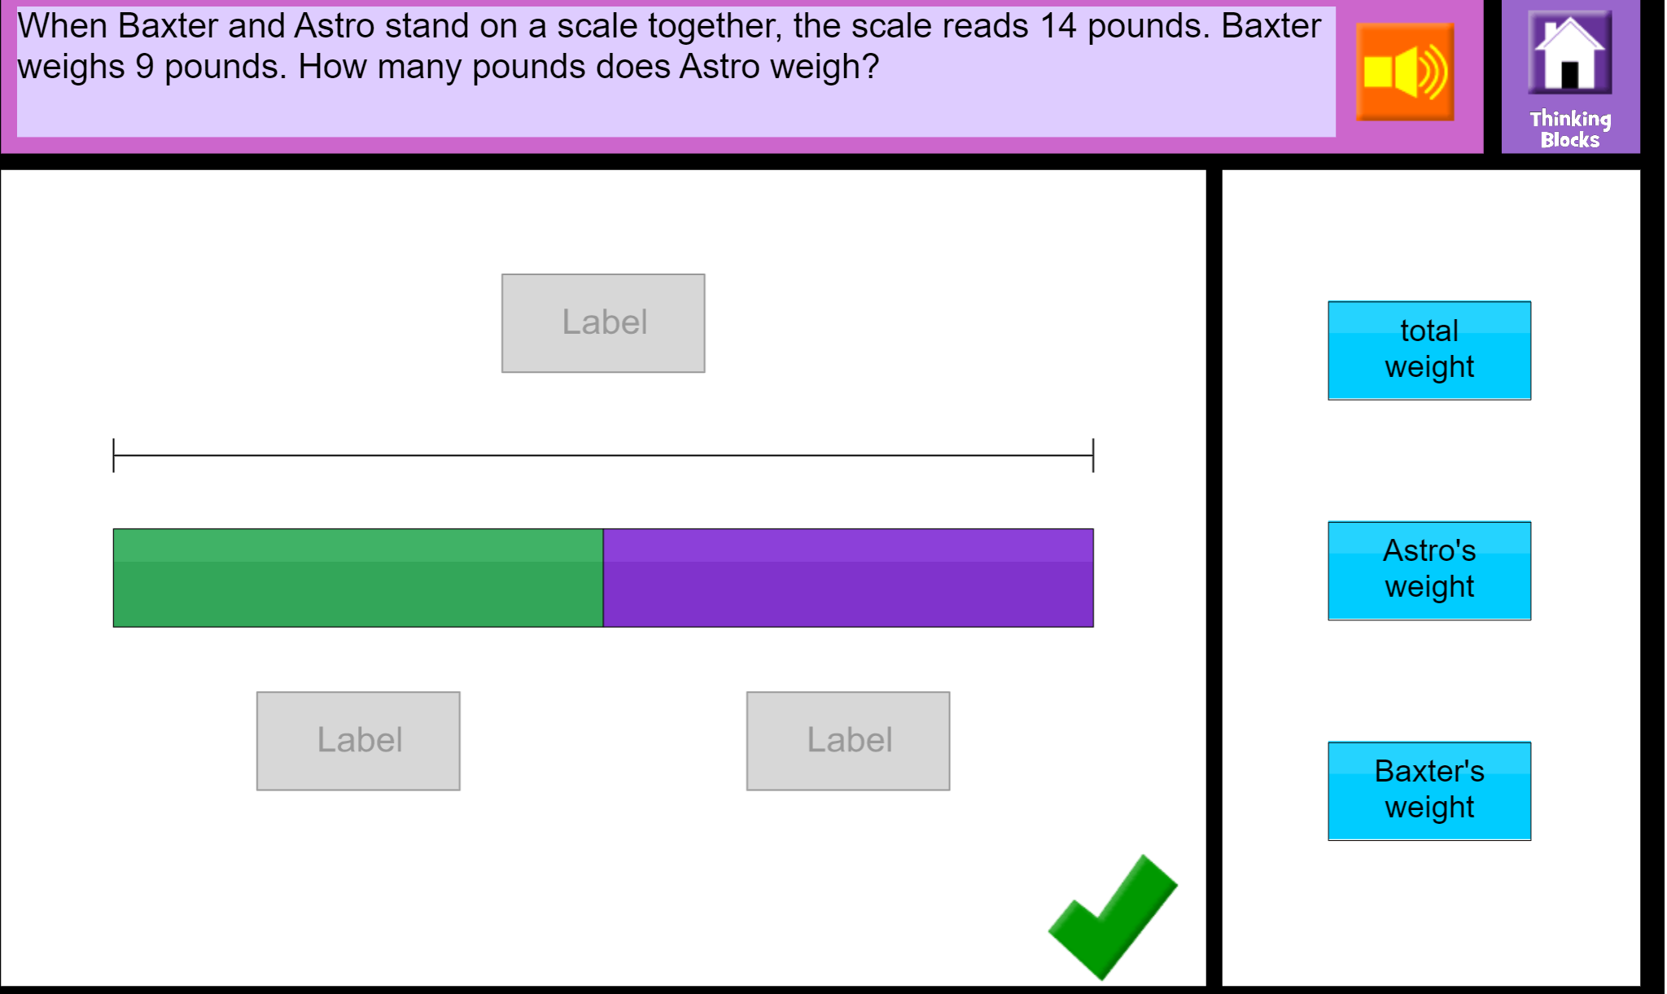
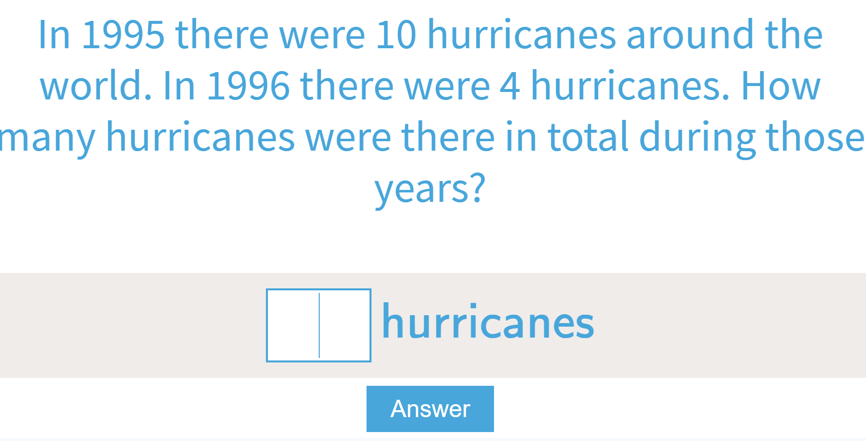
Math
Step 1
Click the video for a review on word problems.
Step 2
Use the clues to solve the problem.
Read to solve the problem.
Step 3
Use items around your house to make a word problem of your own.
Take a picture or make a video and email it to me.
I can solve word problems that relate to addition and subtraction.

Slide 7
DAILY PHYSICAL ACTIVITY
Choose one (or more) activities for your DPA.
GoNoodle
Fresh Start Fitness
Maximo
Calming Down
Mrs. McIntyre DPA

