Slide 1
Biesbroek’s Class 1/2
Thursday, April 2, 2020

Slide 2
Table of contents
Morning Message
Reading
Writing
Math
Daily Physical Activity

Slide 3
Morning message
Hello Kiddos,
Happy Thursday. Hope you didn’t play too many April Fool’s jokes yesterday.
Today we will try words 2-Ways in reading looking at long I sounds, we are making connections to yesterday’s story, and we will practice using the counting on addition strategy.
Happy Learning,
Mrs. Biesbroek

Slide 4
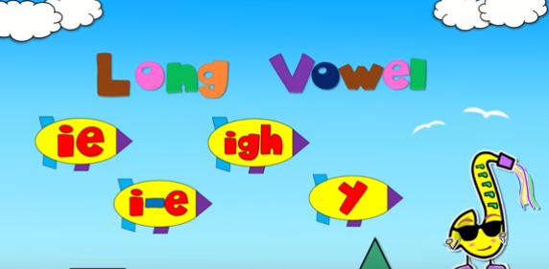
Reading
I can apply a variety of strategies to help solve words.
Step 1
Click and watch the video below.
Step 2
Read a book from home or on RAZ kids.
Find any long I sounds in your book. Remember to try reading words 2-ways using Flippy Dolphin.
Step 3
Share what words you found with a parent or with Mrs. Biesbroek in an email.
Krystal.biesbroek@lethsd.ab.ca

Slide 5
Writing
I can use previous experience to make connections to books.
Step 1
Yesterday we read the book:
Step 2
Readers make Connections –The children and Grandma played a trick on Grandpa. Have you ever played an April Fool’s prank on anyone? What did you do or what could you do?
Step 3
Click the link.
Write your response.

Slide 6
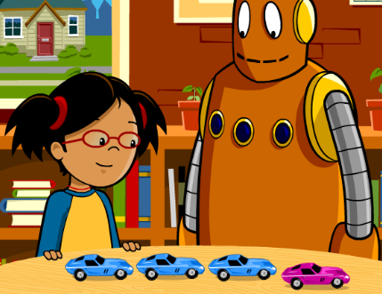
Math
I can show my understanding of adding numbers.
Step 1
Click the video to learn about the counting on strategy.
User: westminster1
Password: westie1
Step 2
Do the EASY or HARD quiz found under the video.
Step 3
Head to the link.
Click the ? and then ENTER. Use counting on to solve the problems.

Slide 7
DAILY PHYSICAL ACTIVITY
Choose one (or more) activities for your DPA.
GoNoodle
Fresh Start Fitness
Maximo
Calming Down

