Slide 1
Biesbroek’s Class 1/2
Friday, June 5, 2020

Slide 2
Table of contents
Morning Message
Reading
Writing
Math
Daily Physical Activity

Slide 3
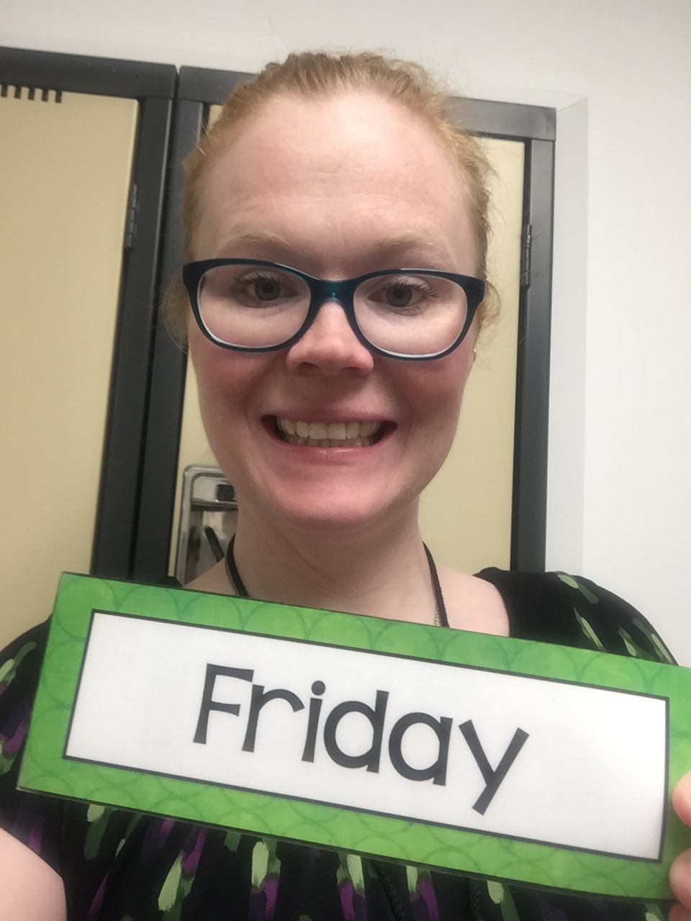
Morning message
Hello Grade 1/2s,
Happy Friday! Are you time professionals now? Today, we will look for ‘ear’ words in our reading, read The Pout-Pout Fish again and test out our comprehension of the story, and look at calendar and dates in Math. I hope you all have a great weekend! See you Monday!
Happy Learning,
Mrs. Biesbroek

Slide 4
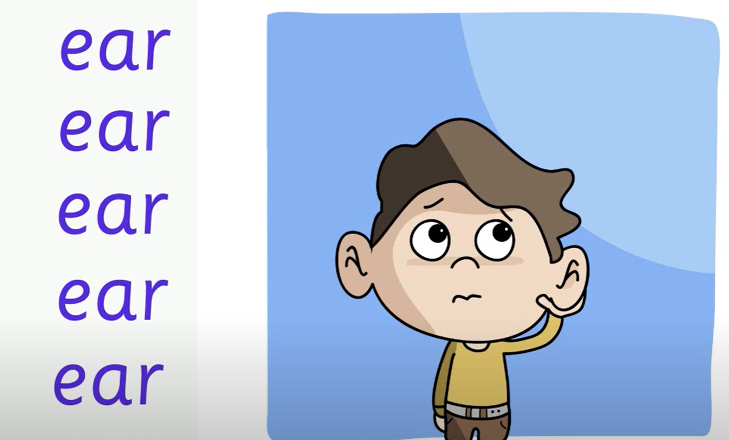
Reading
Step 1
Click and watch the video.
Step 2
Read a book from home or on RAZ kids.
Find any ‘ear’ words in your book. Remember if you get to a tricky word-look for chunks you know by using ‘Chunky Monkey’.
Step 3
Share the words you found with a parent or share it with Mrs. Biesbroek in an email.
I can apply a variety of strategies to help solve words.

Slide 5
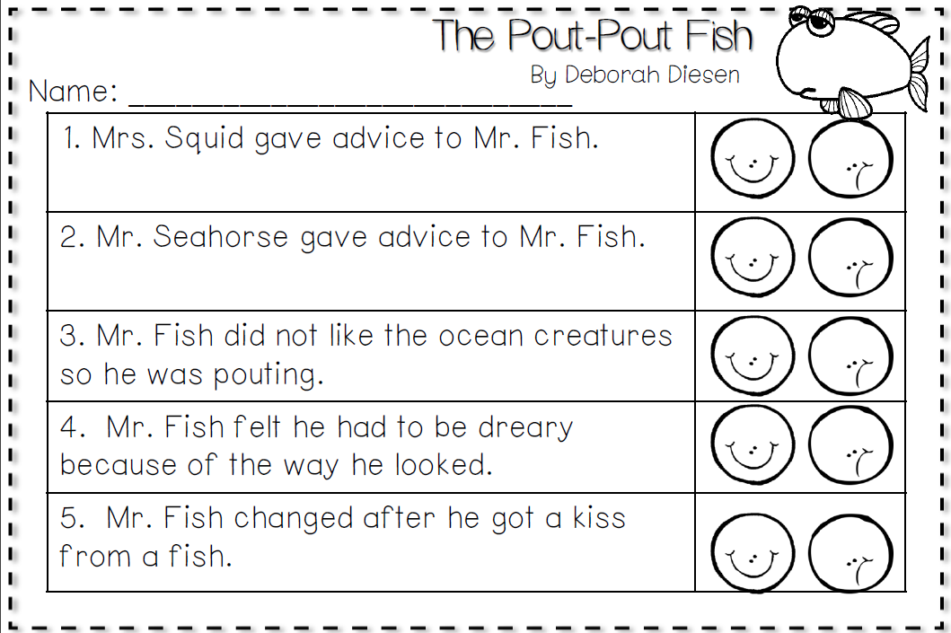
Writing
Step 1
Click the video to listen to Mr. Braico read The Pout-Pout Fish.
Step 2
Read and answer the questions from the comprehension test to see how well you remember the story.
Step 3
Click this video and see the answers to the comprehension test. How did you do?
I can check for capital letters, punctuation and errors in spelling.

Slide 6
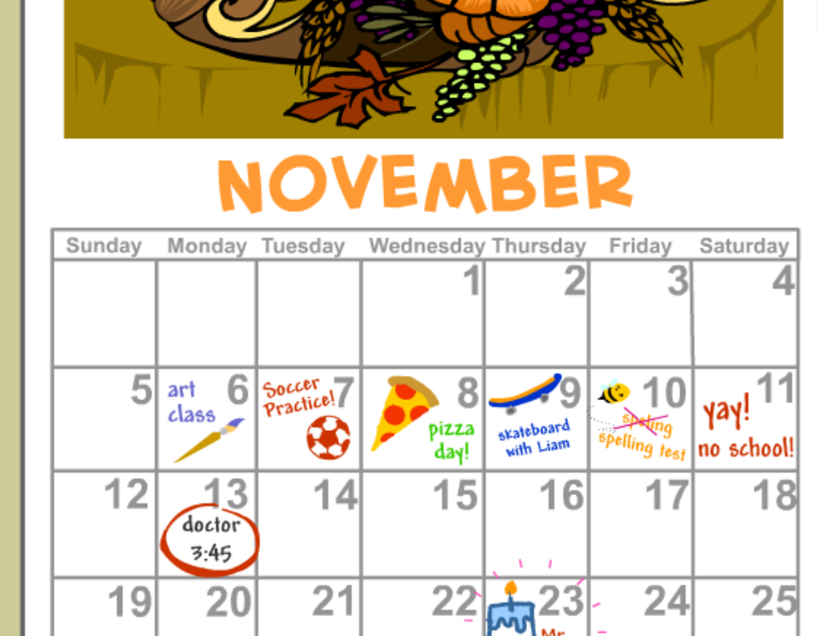
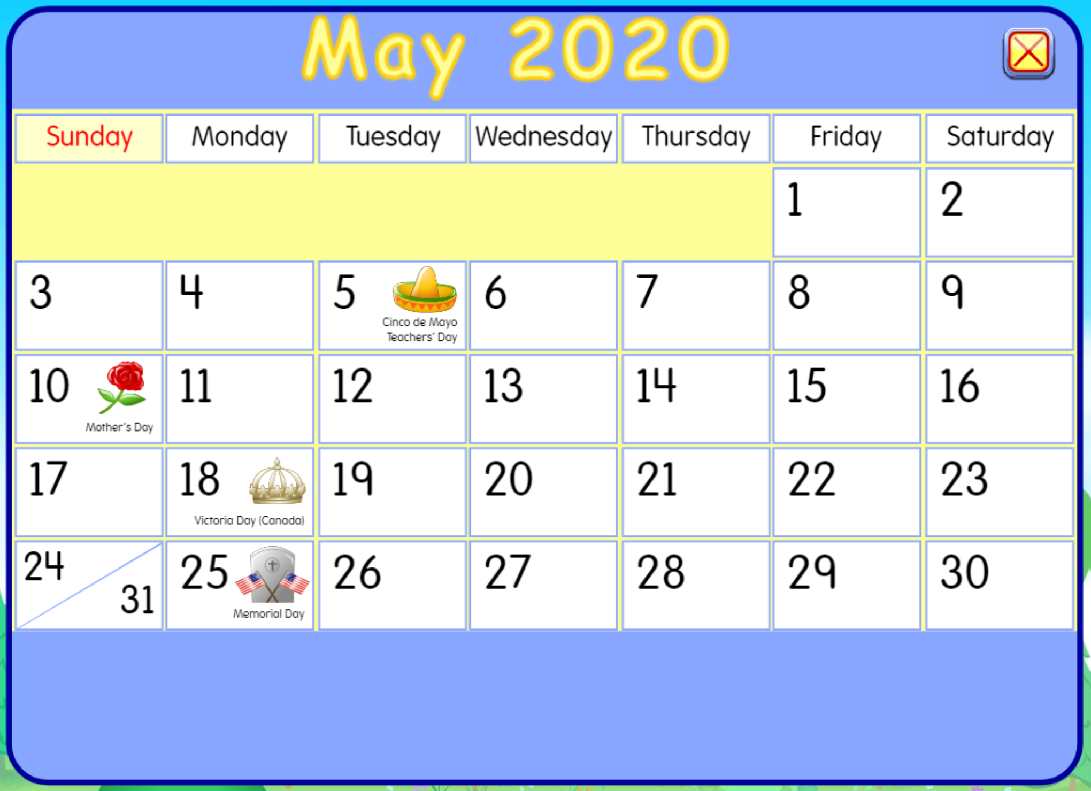
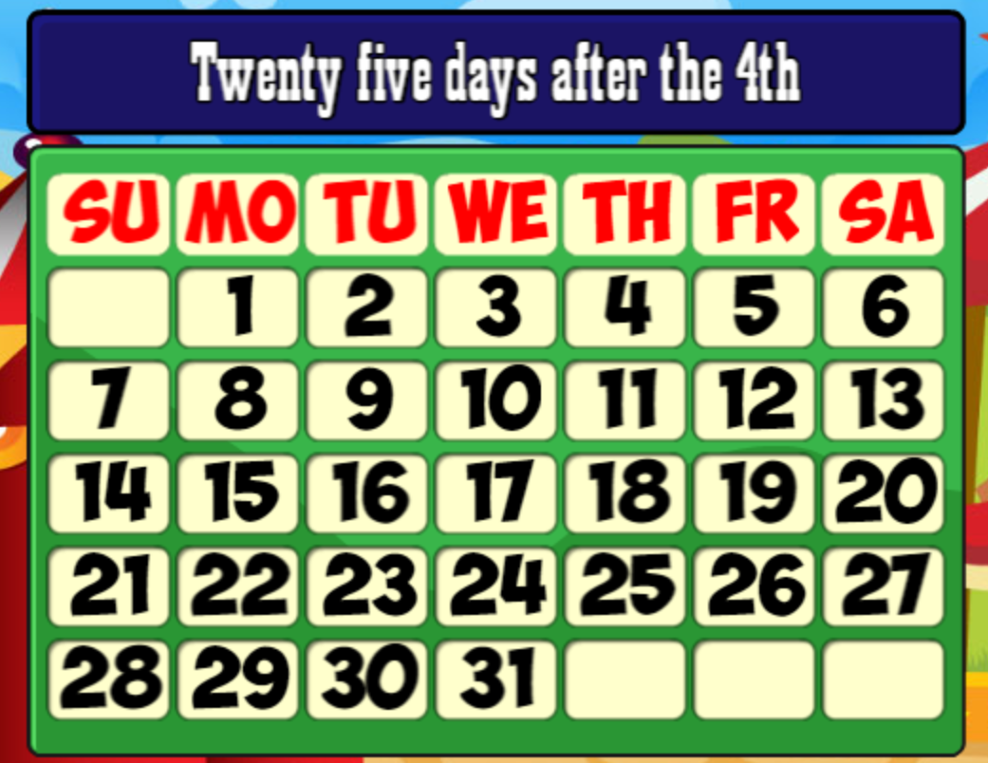
Math
Step 1
Click the video to learn more about calendar and dates.
User: westminster1
Password: westie1
Step 2
Do the EASY or HARD quiz found under the video.
Step 3
Make a calendar.
Solve the word problem to find the date.
I can relate the number of days to a week and months to a year to solve problems.

Slide 7
DAILY PHYSICAL ACTIVITY
Choose one (or more) activities for your DPA.
GoNoodle
Fresh Start Fitness
Maximo
Calming Down
Mrs. McIntyre DPA

