Slide 1
BIesbroek’s Class 1/2
Monday, March 30, 2020

Slide 2
Table of contents
Morning Message
Reading
Writing
Math
Daily Physical Activity

Slide 3
Morning message
Hello Grade 1/2’s,
Happy Monday. Today is our first day of distance learning. Are you excited?
We will work on some reading, writing and math today.
Happy Learning,
Mrs. Biesbroek

Slide 4
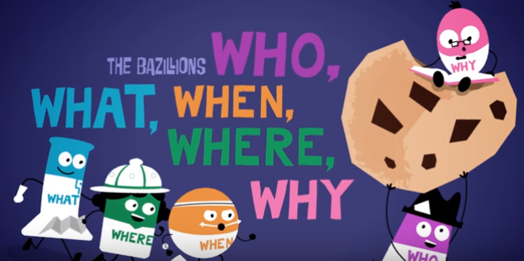
Reading
I can identify important elements of a story.
Step 1
Click and watch the video below
Step 2
Read a book from home or on RAZ kids.
Think about the Who, What, When, Where, and Why of the story.
Step 3
Share your thinking with a parent or share it with Mrs. B in your daily email
Krystal.Biesbroek@lethsd.ab.ca

Slide 5
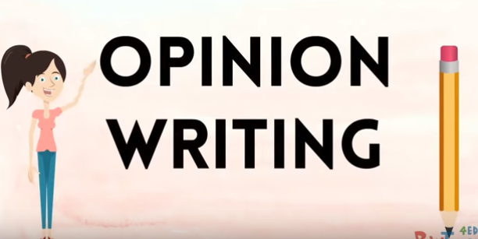
Writing
I can connect my ideas and experiences to a topic.
Step 1
Click and watch the video below.
Step 2
Think about the WORST food to eat with your fingers.
Decide from SPAGHETTI, YOGURT, RICE, or SOMETHING ELSE.
Explain your OPINION.
Step 3
Click the link.
Write your response. Make sure to use the word BECAUSE.

Slide 6
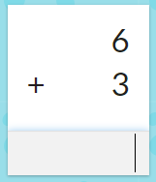
Math
I can show my understanding of adding numbers.
Step 1
Watch Video
Step 2
Click the link.
Choose Addition and a level to answer the flashcards (10 minutes).
Step 3
Click the link.
Choose addition and a level to answer the questions (10 minutes).

Slide 7
DAILY PHYSICAL ACTIVITY
Choose one (or more) activities for your DPA.
GoNoodle
Fresh Start Fitness
Maximo
Calming Down

