Slide 1
BIesbroek’s Class 1/2
Thursday, May 21, 2020

Slide 2
Table of contents
Morning Message
Reading
Writing
Math
Daily Physical Activity
Word Work

Slide 3
Morning message
Hello Kiddos,
Happy Thursday! Who knew compost was so important in growing gardens? Today we look at the ‘gu’ silent letters, we compare A Backyard Garden and Tops and Bottoms, we add more observations of our growing plants, and solve subtraction word problems.
Happy Learning,
Mrs. Biesbroek

Slide 4
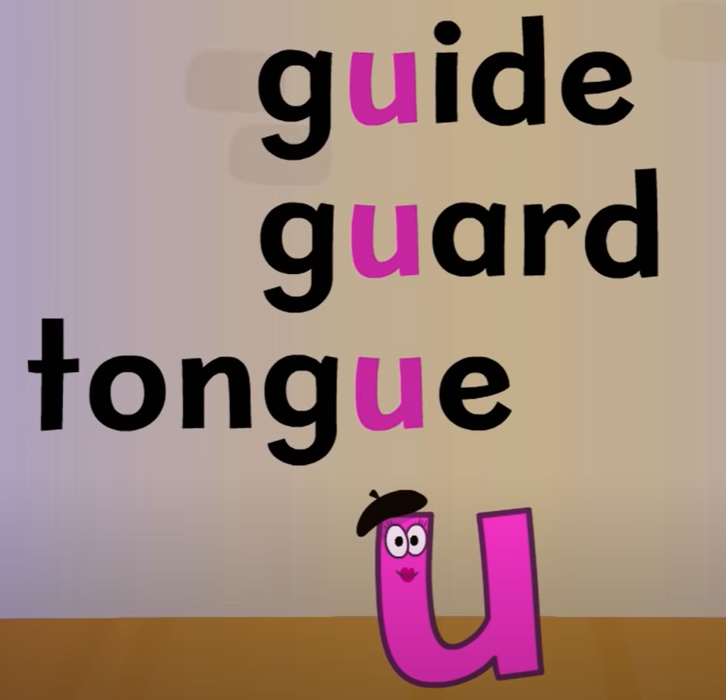
Word work
Step 1
Click and watch the video.
Step 2
Read a book from home or on RAZ kids.
Find any ‘gu’ words in your book. Remember, if ‘g’ and ‘u’ are together, we only say the ‘g’ sound.
Step 3
Share what words you found with a parent or share it with Mrs. Biesbroek in an email.
I can apply a variety of strategies to help solve words.

Slide 5
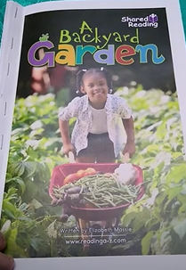
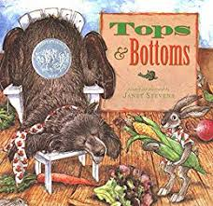
Reading
Step 1
Click and watch the video on comparing and contrasting information.
Step 2
Compare and contrast how “A Backyard Garden” and “Tops and Bottoms” are the same and how they are different.
Step 3
Share with a parent or sibling about how the books are the same and how they are different. Tell them 3-5 key facts you learned from the story.
I can connect ideas in stories to other stories I have read.

Slide 6
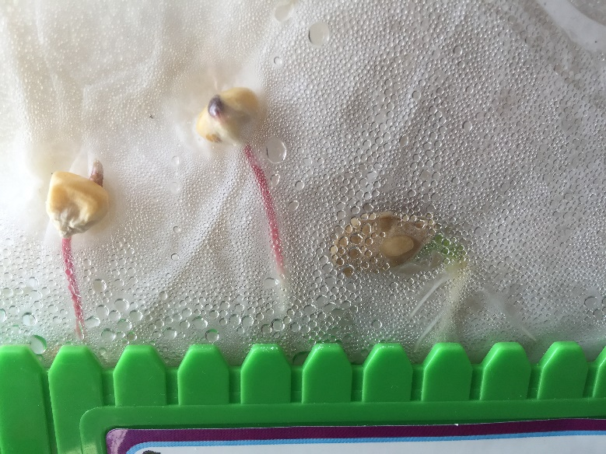
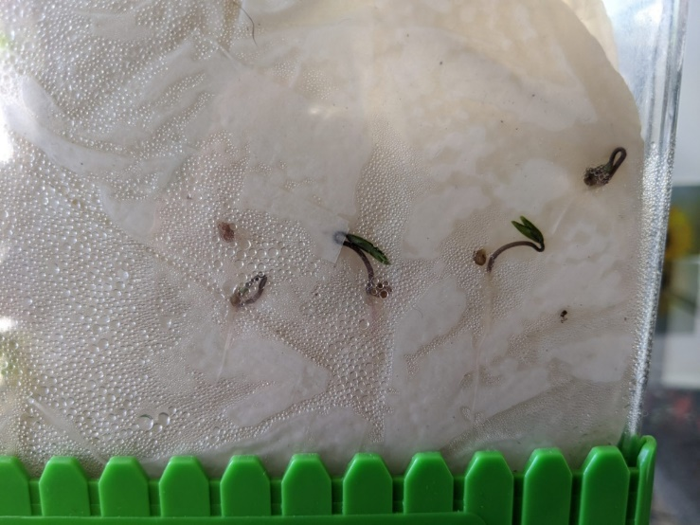
Writing
Step 1
Day 3 - Take a look at the picture today, what have you noticed? What has changed from yesterday?
Step 2
Write down 3 observations you noticed from the pictures into your Word document. Please remember to save your work.
I can describe my observations of objects.

Slide 7
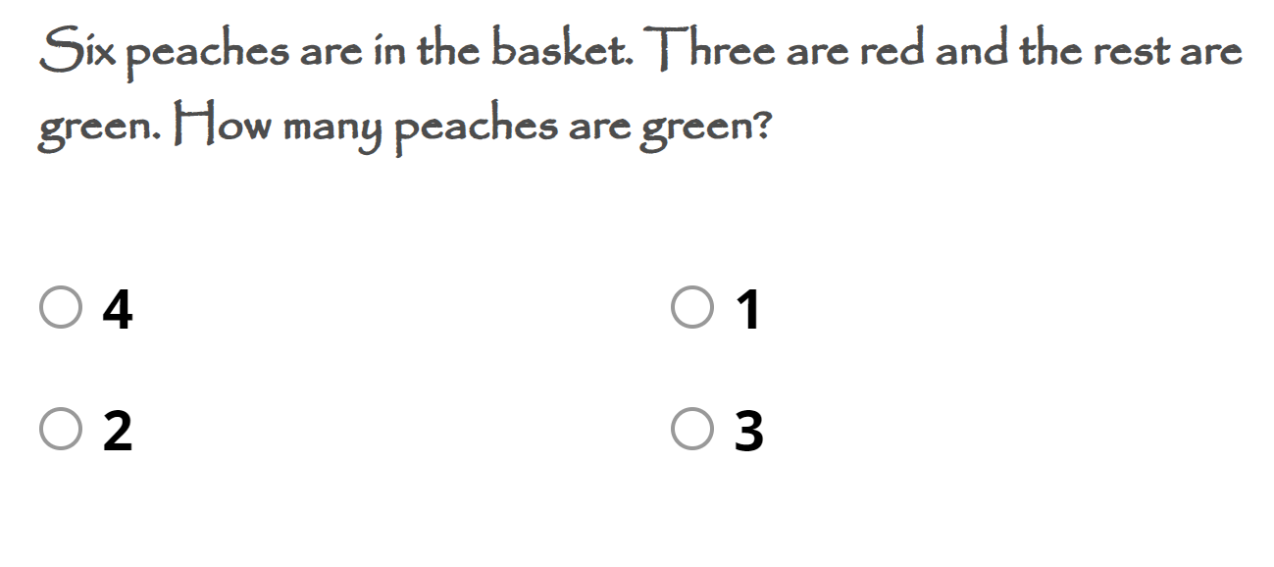
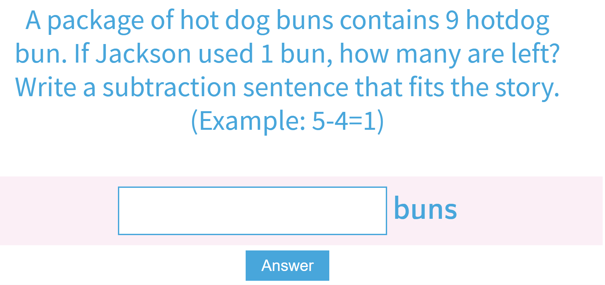
Math
Step 1
Click the video to learn more solving subtraction word problems.
Step 2
Choose the correct answer to solve the word problem.
Step 3
Use the clues to help solve the word problems.
Listen to the sentence to solve the word problem.
I can solve problems that involve subtraction.

Slide 8
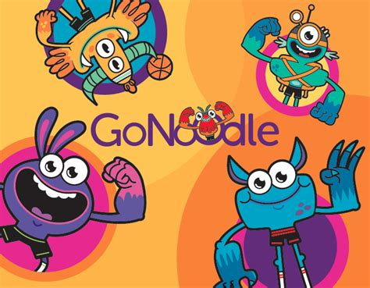
DAILY PHYSICAL ACTIVITY
Choose one (or more) activities for your DPA.
GoNoodle
Fresh Start Fitness
Maximo
Calming Down
Mrs. McIntyre DPA

