Slide 1
Biesbroek’s Class 1/2
Friday, May 15, 2020

Slide 2
Table of contents
Morning Message
Reading
Writing
Math
Daily Physical Activity

Slide 3
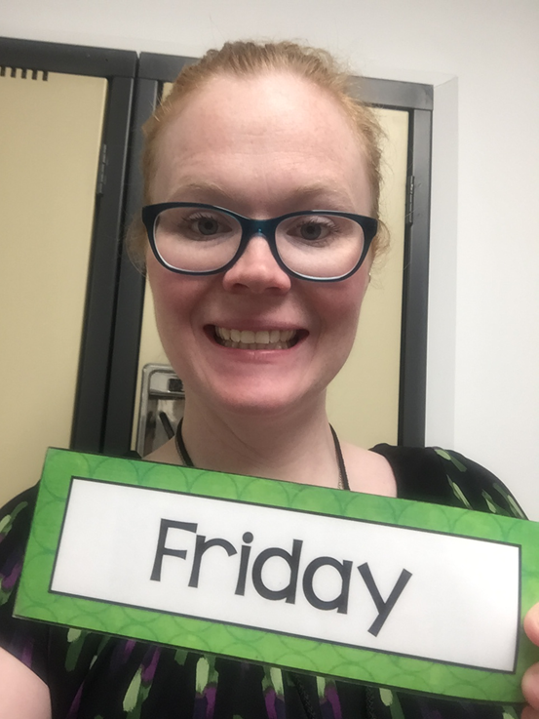
Morning message
Hello Grade 1/2s,
Happy Friday! Which data graph or chart do you like the best? Today, we will look for ‘sw’ words in our reading, listen to Goldilocks and the Three Dinosaurs and test out our comprehension, and put all our data managing skills together in Math. Also, have a great long weekend. We will be back on May 19th.
Happy Learning,
Mrs. Biesbroek

Slide 4
Reading
Step 1
Click and watch the video.
Step 2
Read a book from home or on RAZ kids.
Find any ‘sw’ words in your book. Remember if you get to a tricky word, skip it, read the rest and go back – like Skippy Frog.
Step 3
Share your words you found with a parent or share it with Mrs. Biesbroek in an email.
I can apply a variety of strategies to help solve words.

Slide 5
Writing
Step 1
Click the video to listen to Mr. Braico read Goldilocks and the Three Dinosaurs.
Step 2
Read and answer the questions from the comprehension quiz to see how well you remember Goldilocks and the Three Dinosaurs.
Step 3
Click this video and see the answers to the comprehension quiz. How did you do?
I can check for capital letters, punctuation and errors in spelling.

Slide 6
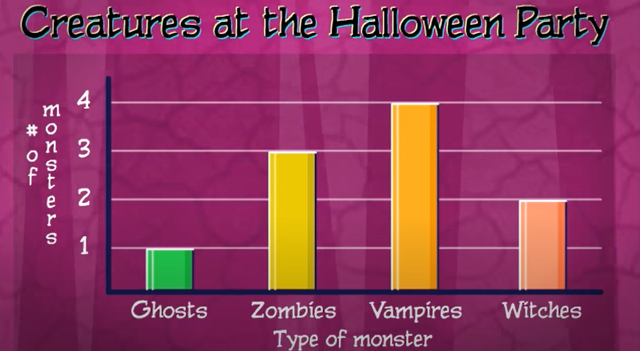
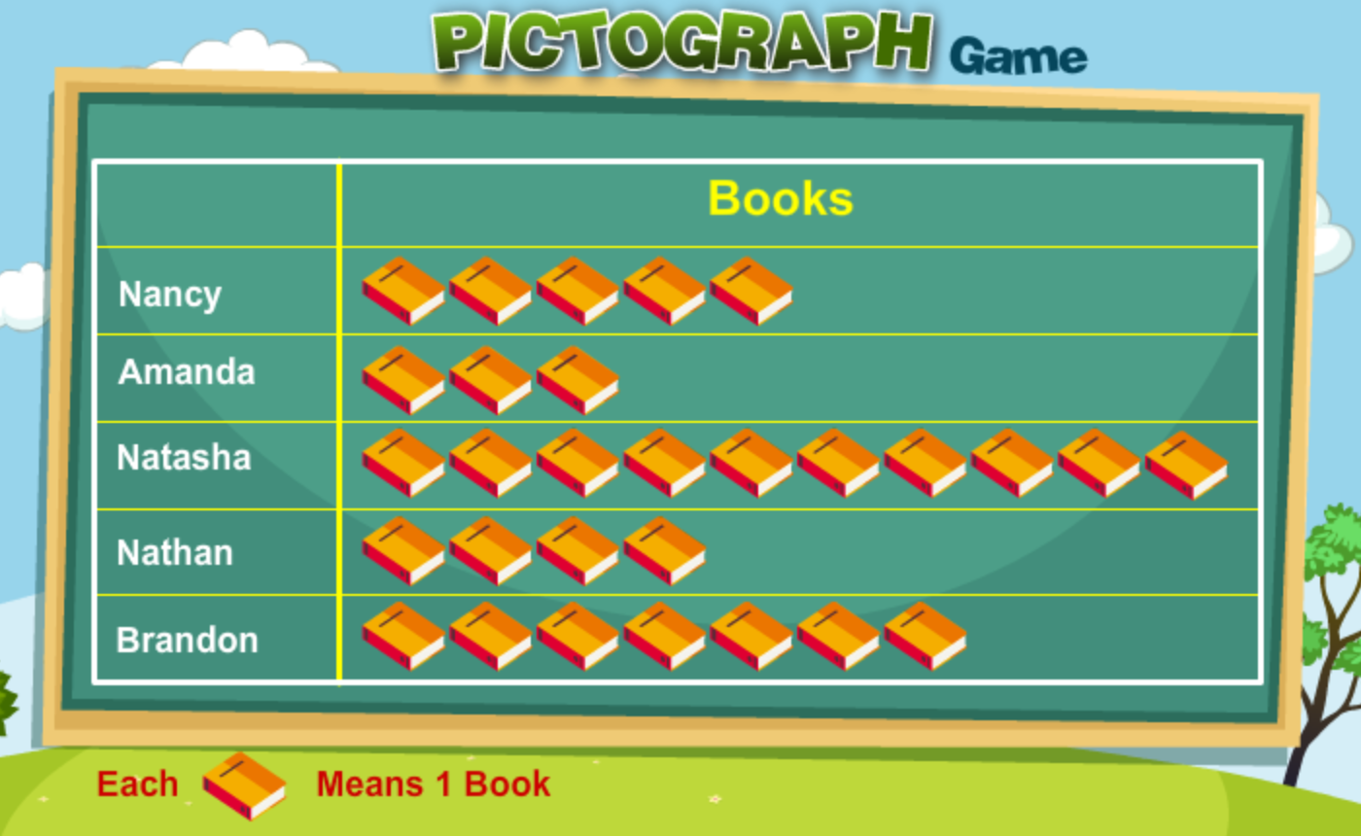
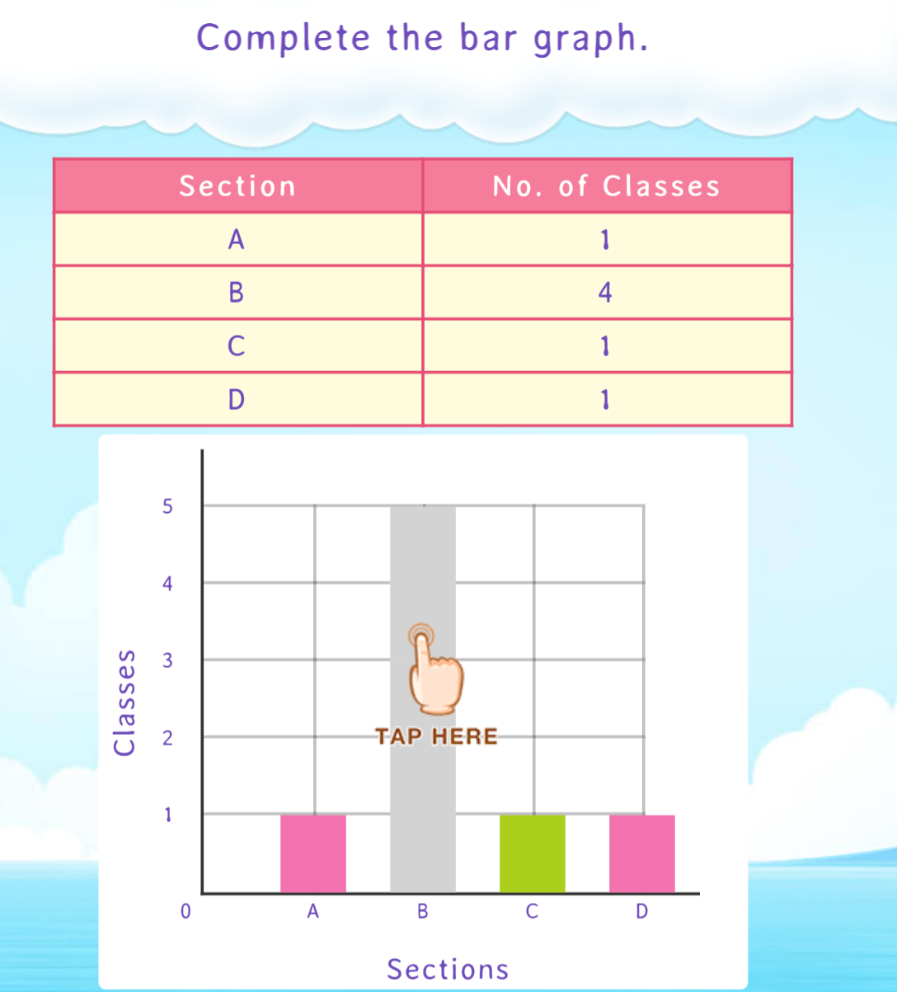
Math
Step 1
Click the video to learn more about the different ways to manage data.
Step 2
Practice your data skills on a pictograph.
Step 3
Try any of the games on Splash Learn.
Click Sign In → Class → JUMJUU → find name
Password: 1234
I can construct and interpret graphs to solve problems.

Slide 7
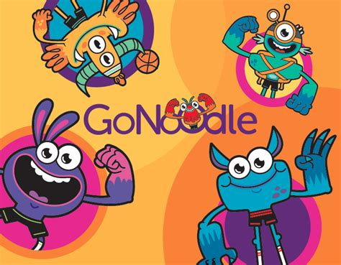
DAILY PHYSICAL ACTIVITY
Choose one (or more) activities for your DPA.
GoNoodle
Fresh Start Fitness
Maximo
Calming Down
Mrs. McIntyre DPA

