Slide 1
Biesbroek’s Class 1/2
Wednesday, April 22, 2020

Slide 2
Table of contents
Morning Message
Reading
Writing
Math
Daily Physical Activity
Word Work

Slide 3
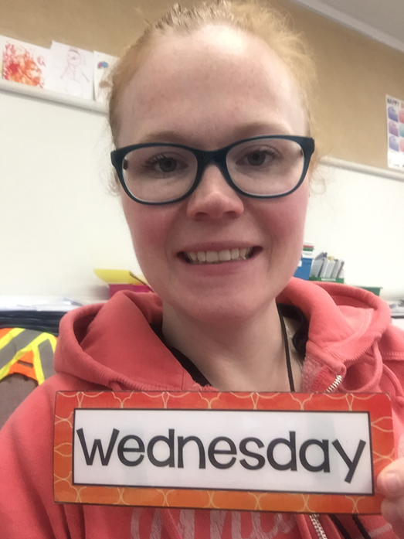
Morning message
Hello Boys & Girls,
Happy Earth Day! Think about some things you are grateful for about the Earth. Today we will be looking at the ‘ir’ controlled vowel, we will continue with Tops and Bottoms to learn about plot conflict or problems and solutions in stories, and we will be looking closer at 2D shapes.
Happy Learning,
Mrs. Biesbroek

Slide 4
Word work
Step 1
Click and watch the video.
Step 2
Read a book from home or on RAZ kids.
Find any ‘ir’ words in your book. Remember you can break down words using Chunky Monkey.
Step 3
Share what words you found with a parent or share it with Mrs. Biesbroek in an email.
I can apply a variety of strategies to help solve words.

Slide 5
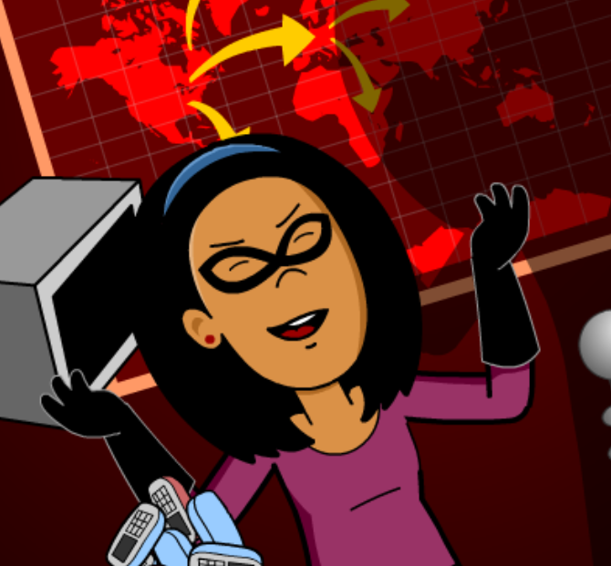
Reading
Step 1
Click and watch the video on plot.
Step 2
Click and watch Mr. Braico reading Tops and Bottoms. Think about the plot. What happens during the story? What is the problem? How does it get solved?
Step 3
Write your answers in BrainPop Jr.
I can identify what happens in stories.

Slide 6
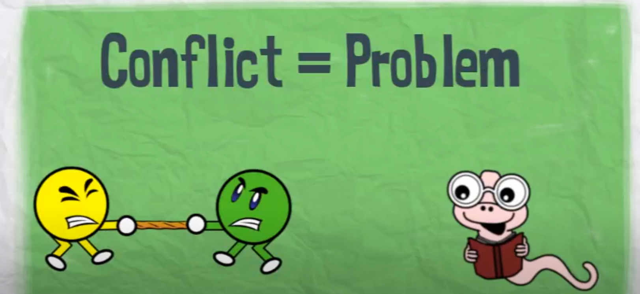
Writing
Step 1
Click the video to learn more about writing conflict or problems and solutions.
Step 2
Today when planning your story, think of a conflict or problem that your characters need to solve. For example, does your character lose something? How do they get it back?
Step 3
Write in the “My Story” document and add a conflict or problem that happen to your characters. How do they solve this problem? Remember to save your work.
I can create narrative stories where the main characters perform actions.

Slide 7
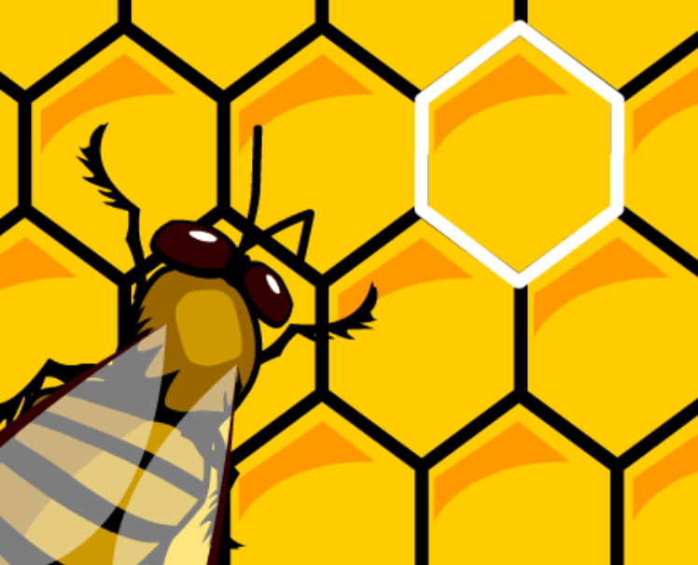
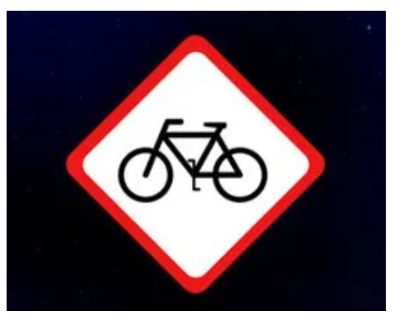
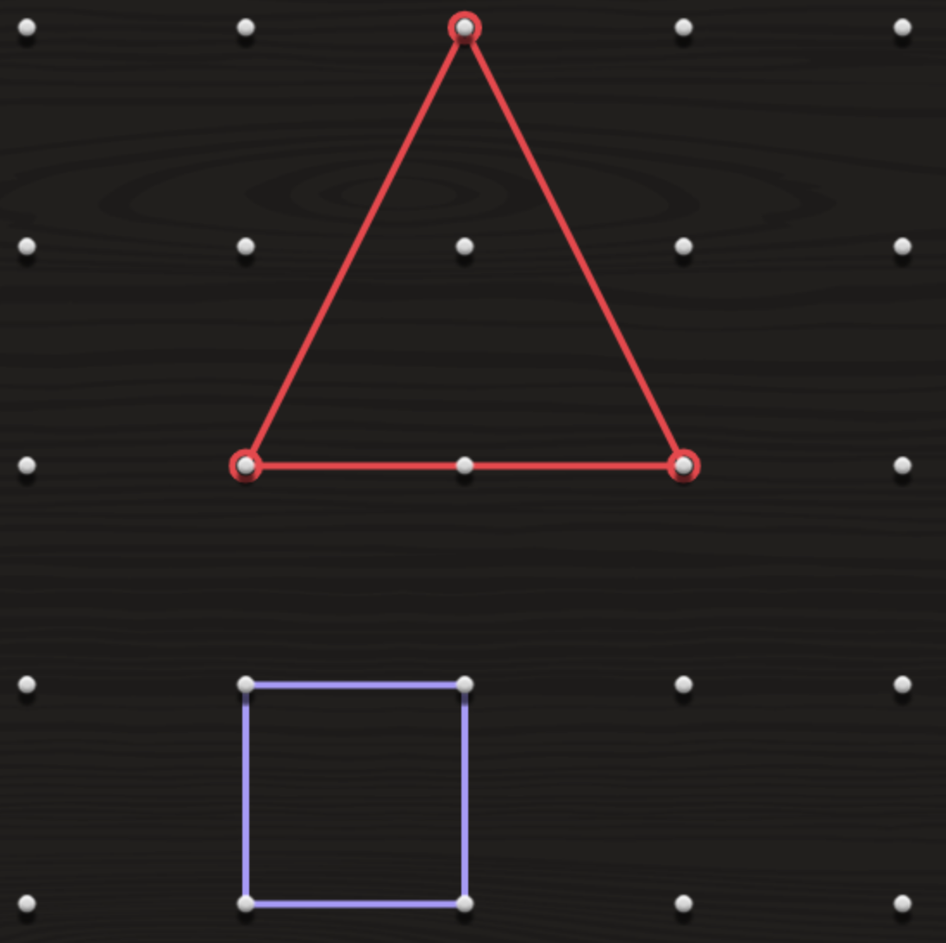
Math
Step 1
Click the video to learn more about different types of 2D Shapes.
User: westminster1
Password: westie1
Step 2
Do the EASY or HARD quiz found under the video.
Step 3
Identify the Two-Dimensional Shapes in Grade 2.
Click Sign In → Class → JUMJUU → find name
→ Password: 1234
Use the geoboard to make different 2D shapes.
I can identify and sort 2D shapes based on attributes.

Slide 8
DAILY PHYSICAL ACTIVITY
Choose one (or more) activities for your DPA.
GoNoodle
Fresh Start Fitness
Maximo
Calming Down
Mrs. McIntyre DPA

