Slide 1
Art Choice Board

Slide 2
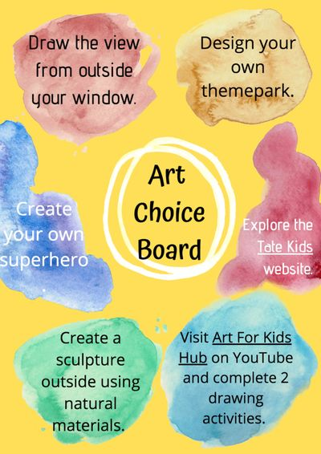
Wallpaper for fun 5

Slide 3
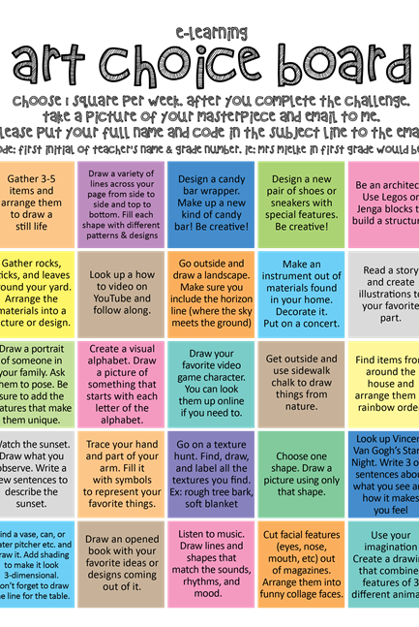
Art Choice Board

